Slide 1

New STEREO/SECCHI Processing for Heliospheric Transients
David F. Webb
ISR, Boston College, MA, USA
david.webb@bc.edu
New England Space Science Consortium meeting
UNH, NH
24 October 2012

Slide 2


OUTLINE - BACKGROUND
Coronal mass ejections (CMEs) involve expulsion of significant amounts of mass and magnetic flux into heliosphere
- Implies continuous buildup of the net interplanetary magnetic flux (IMF)
But over time IMF varies with solar cycle, open flux varies ~50%.
- So a buildup is not observed
  - Thus, reconnection/disconnection of the flux near Sun seems required but observing evidence of it in heliosphere has been illusive
Field line reconnection in wake of CMEs is a fundamental aspect of some magnetically driven eruptive flare/CME models.
- Such a “standard” model features a growing hot loop arcade beneath a rising X-type
neutral point connected to the retreating CME
- Recent versions → rising CME & hot arcade connected by stretched current sheet (CS)
Candidate disconnection events & CSs identified observationally:
- In lower atmosphere → hot arcades with cusps, looptop HXR sources, XUV rays, inflows
and downflows
- In corona near Sun → in WL as narrow rays trailing outward-moving CMEs and in UV
spectra as narrow bright, hot features
- In inner heliosphere (STEREO) as U-shaped loops and voids
  2-D and 3-D models developed involving Petschek reconnection, MHD of CME evolution, numerical reconnection, and steady vs bursty reconnection in CS (will not discuss)

Slide 3
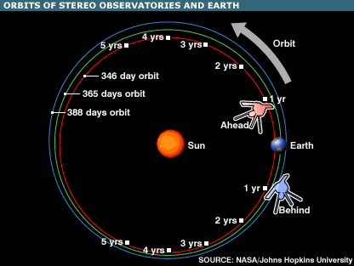
New Results from STEREO SECCHI Imagers on CMEs, Magnetic Clouds & Disconnection Events in the Heliosphere

Slide 4
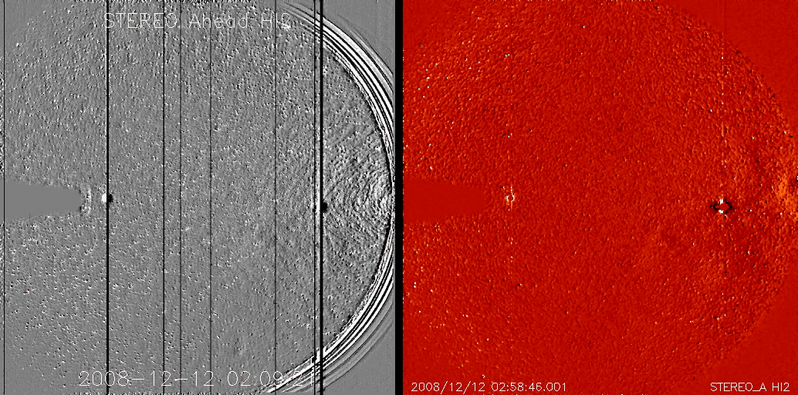
STEREO Heliospheric Imagers
Improvements in Data Processing
HI-2A
3

Slide 5
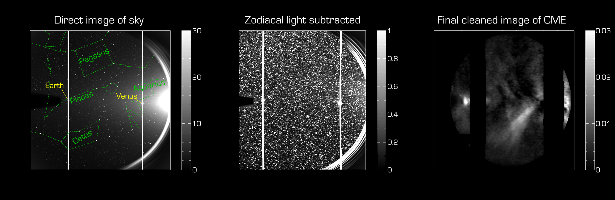
The Difficulty of Heliospheric Imaging
• Thomson-scattered light at 45° → 1000 times fainter than background.
• Starfield identification and removal is a very challenging task.
Successful new processing technique: DeForest et al., ApJ, 2012

Slide 6
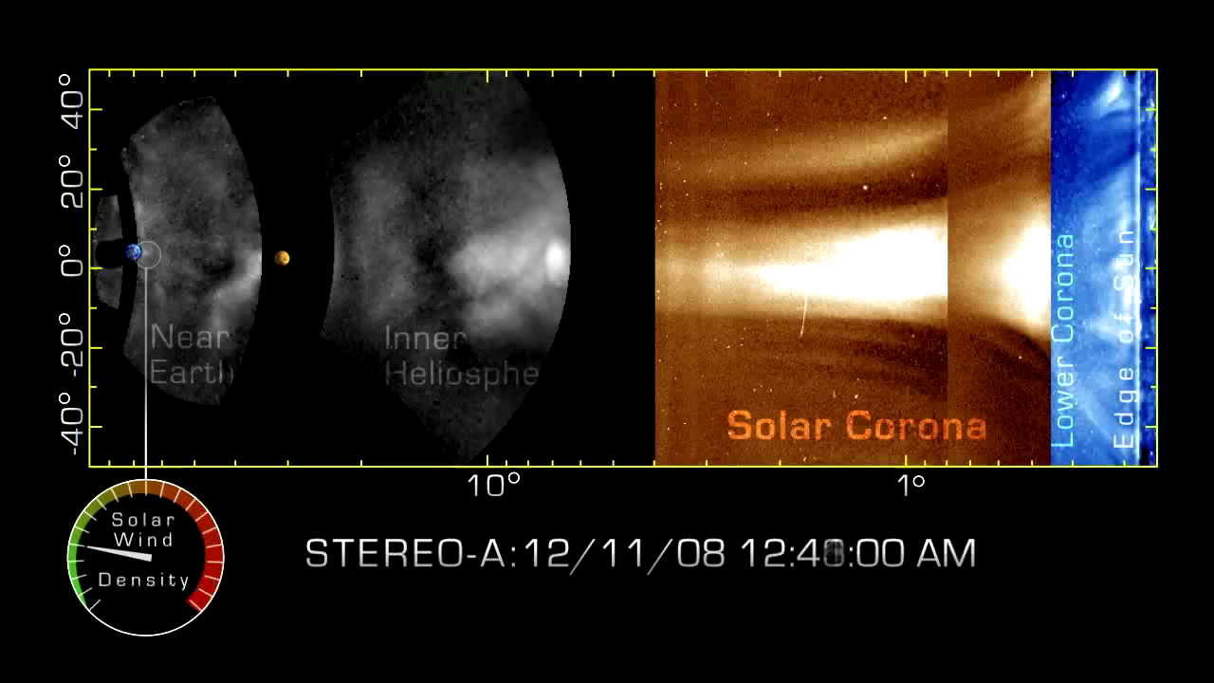
SECCHI – 2011-12 New Processing Technique (SWRI)

Slide 7
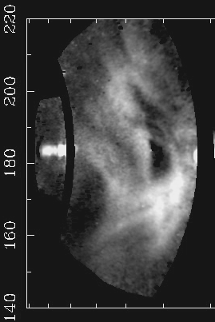
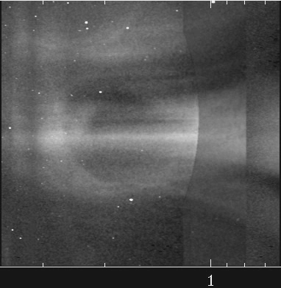
Track CME Flux Rope in Heliosphere
HI-2A
COR-2A
10
Howard & DeForest, ApJ, 2012

Slide 8
Disconnection event of 18 Dec. 2008.
Formation & evolution of U-loop.
DeForest, Howard & McComas, ApJ, 2012

Slide 9
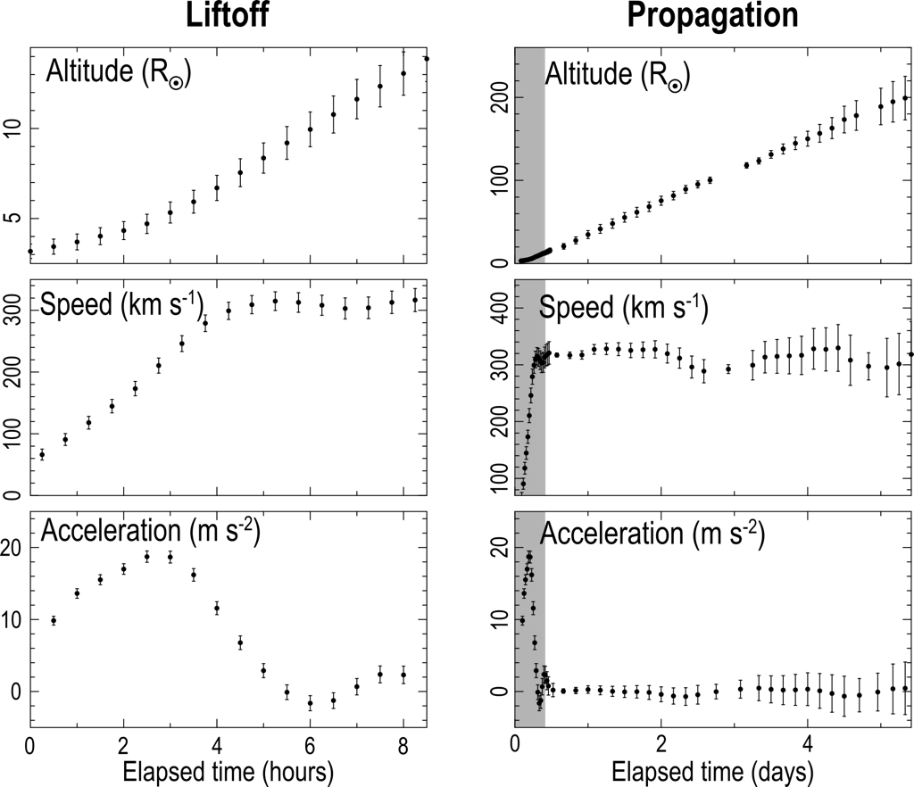
Analysis of DE in Solar Wind
14

Slide 10
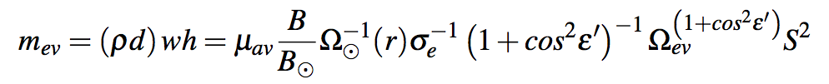
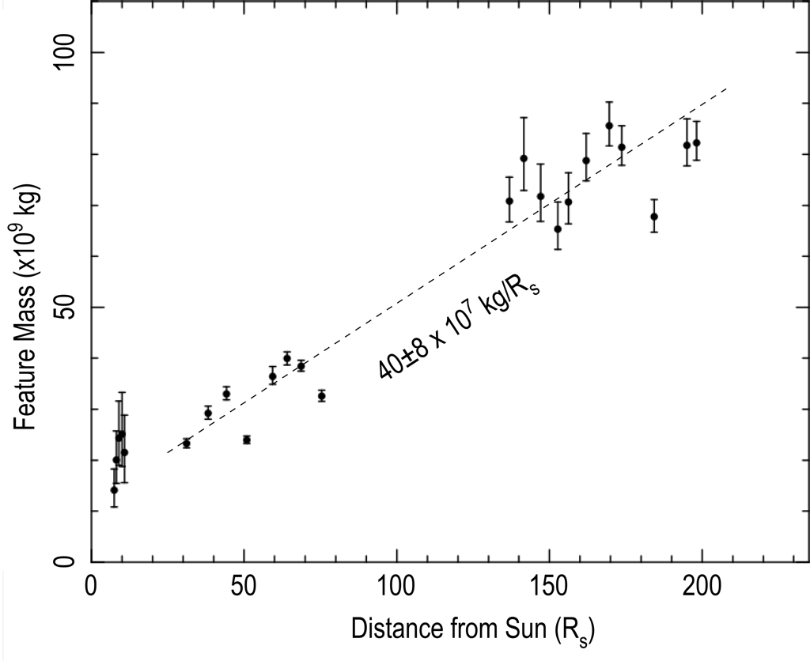
Analysis of DE in Solar Wind
S²
Distance to feature
Apparent size of feature
Thomson geometric factor
Thomson cross section
Accretion in 1 AU:
from 20 Tg to 80 Tg (4X!)
Solar solid angle from feature’s vantage
Feature brightness
Average mass per electron (proton mass * 1.1)
15

Slide 11
CONCLUSIONS
CMEs carry magnetic flux & helicity into heliosphere but flux buildup not observed
Evidence of current sheets and disconnection (Concave-Outward structure, rays) observed in lower atmosphere and corona
- Rays/CSs in at least 10% of all WL CMEs
- But are they frequent enough to balance flux?
- Some CS parameters measured but we need a full description
In new STEREO data set CME structures and DE features now easily visible and common, even at solar minimum
STEREO DE accretes 4X its initial mass over 1 AU
DE has entrained flux = 2 X 10¹⁹ Mx
- ~ 1 month est. yields rate of 1/day and discon. rate = 6 X 10²¹ Mx/yr
- At 1 AU amounts → about 10% of observed rate of change of open
field at 1 AU (Schwadron et al., ApJ, 2010)
- Thus this mechanism is important to heliospheric flux balance

