Slide 1
Title
NESSC, Fall Meeting 2012
Matthew Gorby
University of New Hampshire
Particle acceleration due to CME driven shocks, from low in the corona to 1AU

Slide 2
Outline
Outline
EMMREM
Current Project
MAS
May 1997
Forced CME
Future Work

Slide 3
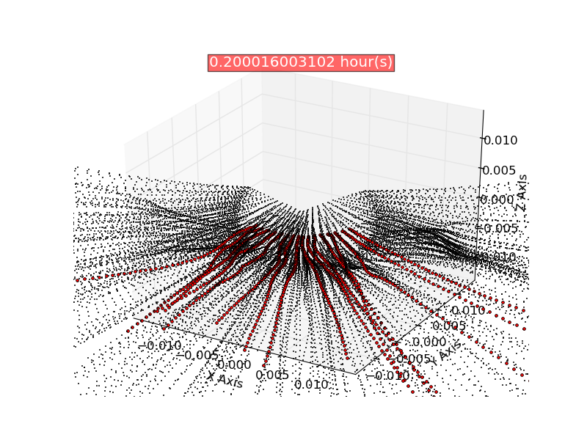
EMMREM
Advances the focused transport equation on a Lagrangian grid
Naturally adapts to the geometry of the system
“Easily” couples to external MHD simulations

Slide 4
Current project
- Currently we are coupling to Predictive Science’s MHD simulation, MAS (Magnetohydrodynamics Around a Sphere).
- They give us a time series of all of the fields, from one to twenty solar radii.
- We’ve been running EMMREM with the parallel diffusion and adiabatic terms turned on, but cross-field diffusion disabled.
- We implemented a shock finder and the ability to sharpen discontinuities, combat diffusion in the MHD simulations.
- Investigating the role of the mean free path in accelerating particles near the shock as well as getting them out to 1AU.

Slide 5
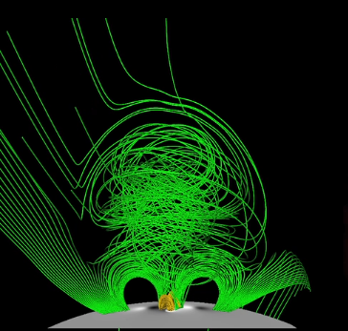
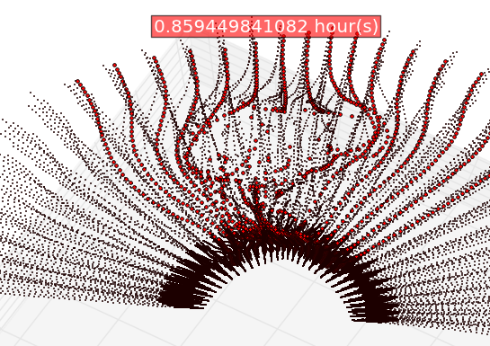
MAS :: simulation explanations
Two events:
May 1997
Forced CME
MAS
EMMREM

Slide 6
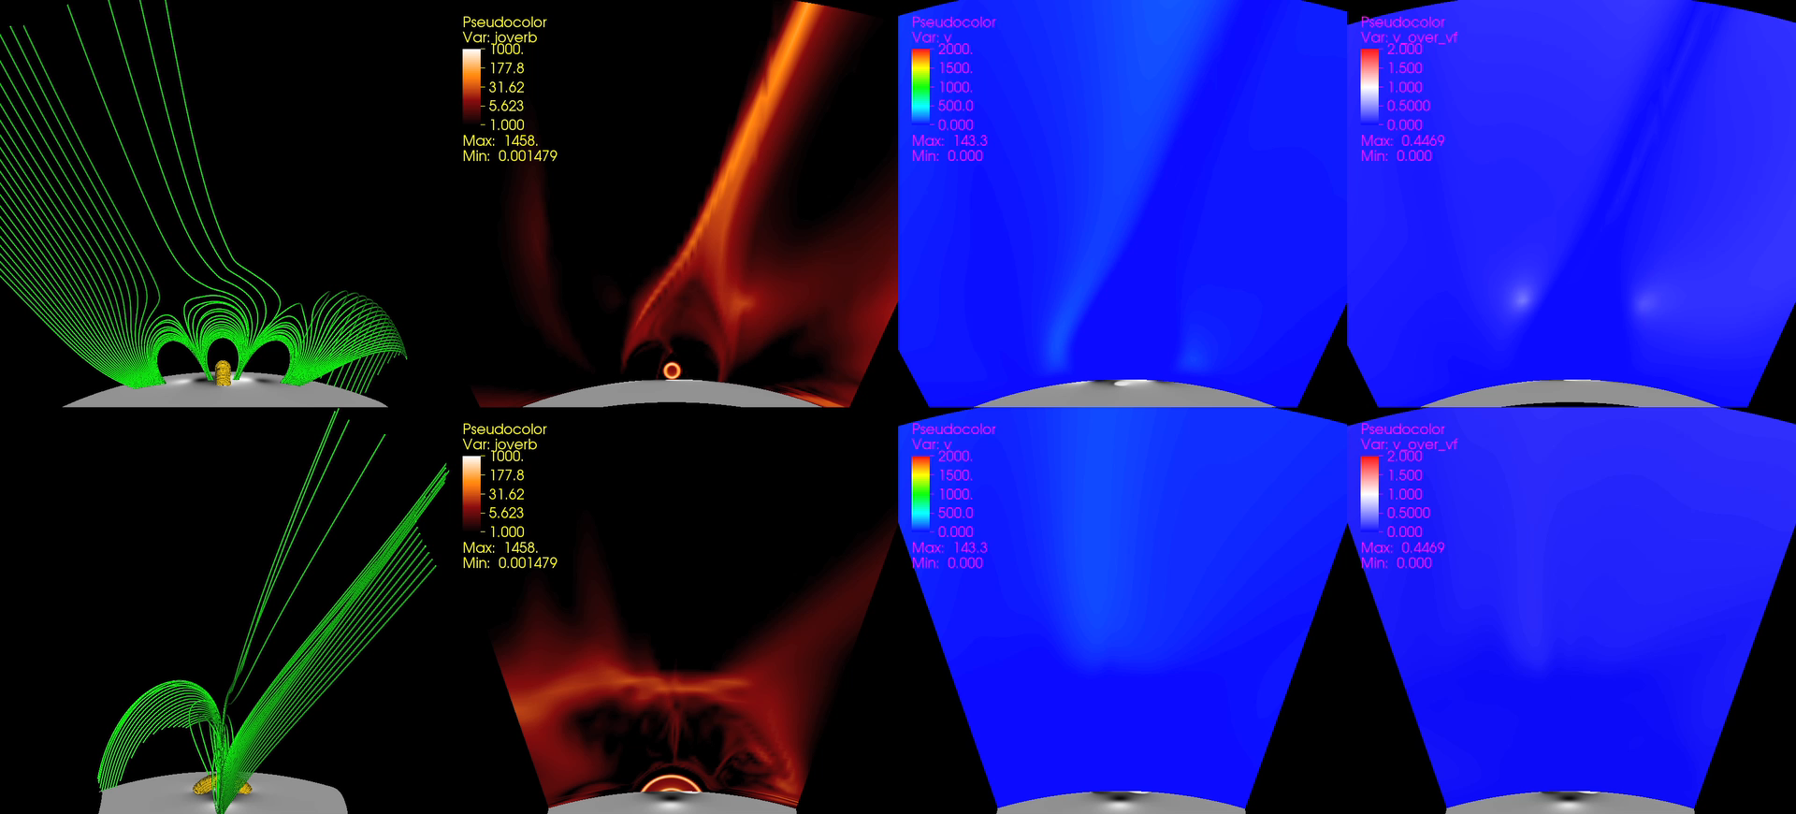
MAS :: movie

Slide 7
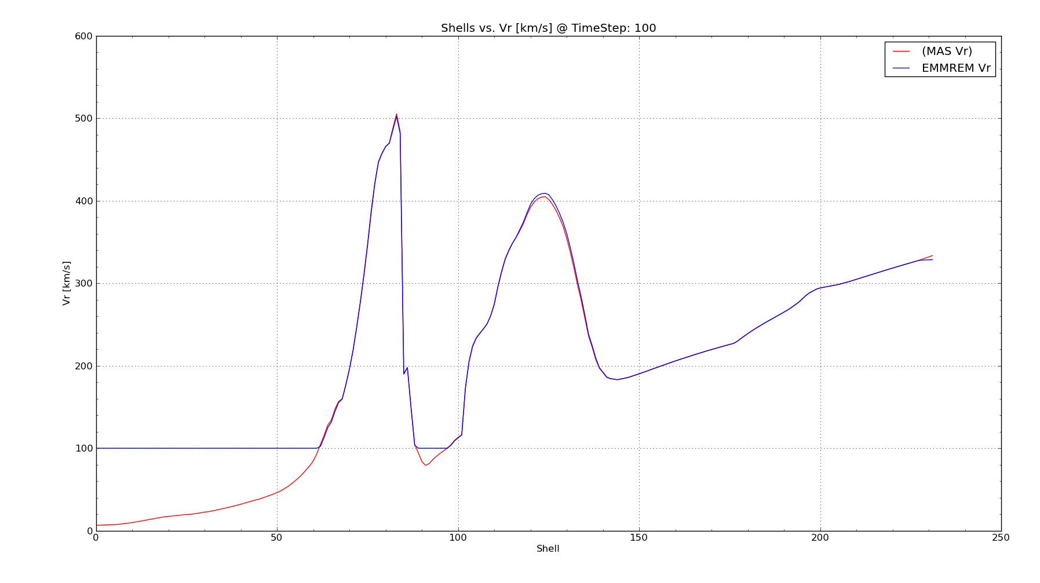
MAS :: verification and validation

Slide 8
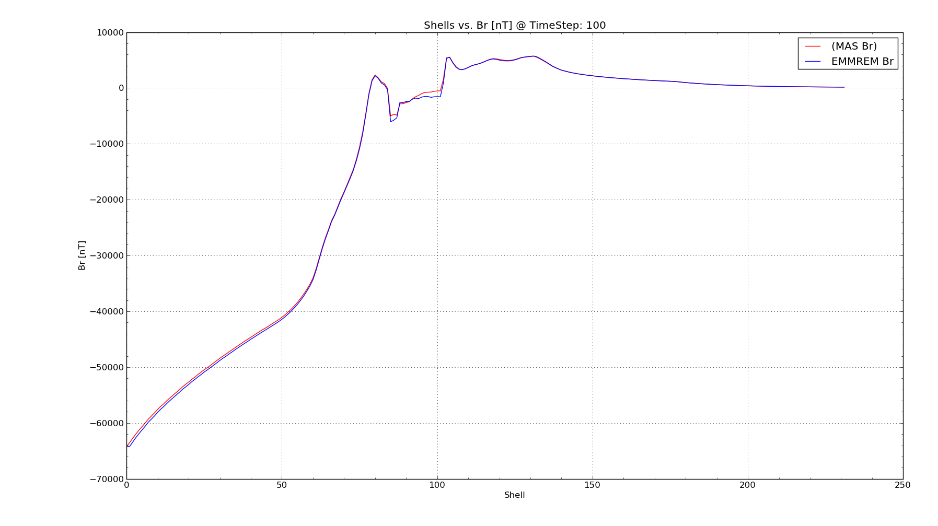
MAS :: verification and validation

Slide 9
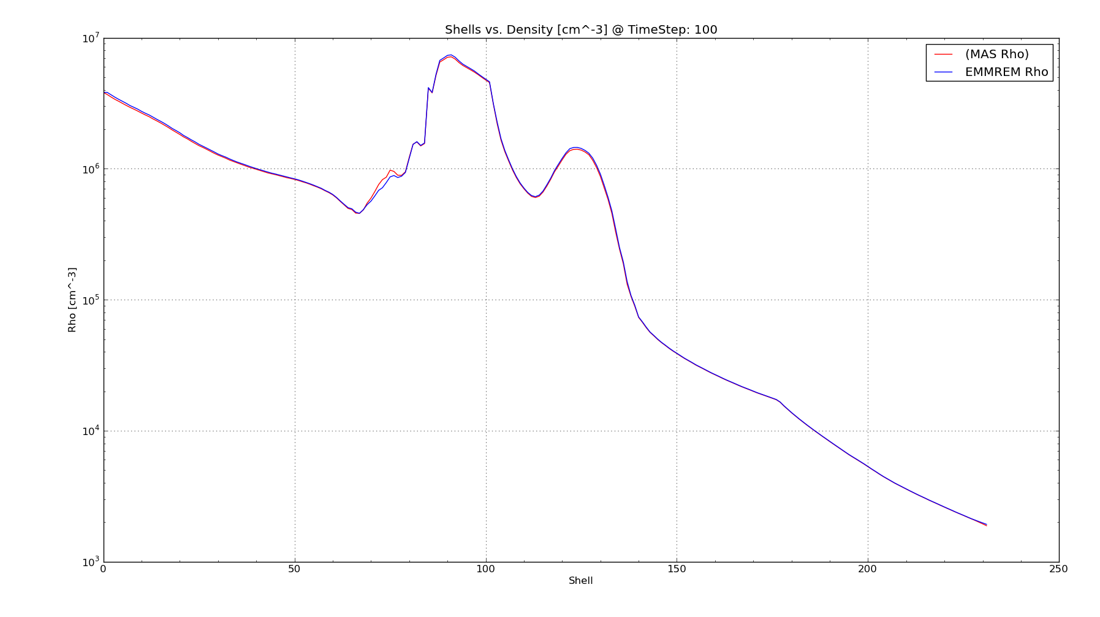
MAS :: verification and validation

Slide 10
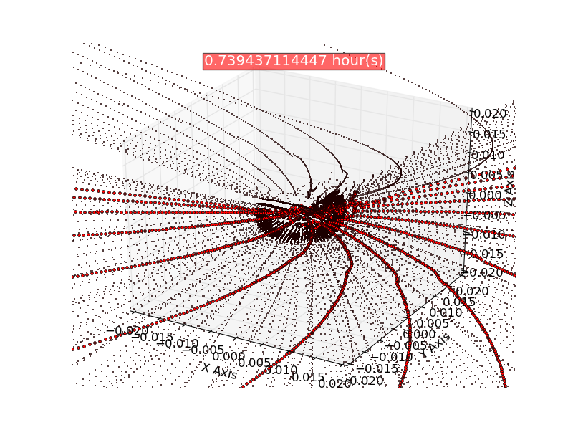
May 1997
Large, uniform time steps.
No shock-finder.
The mean free path scales as radius to the 0.15, rigidity to the 1/3, and density over background density.

Slide 11
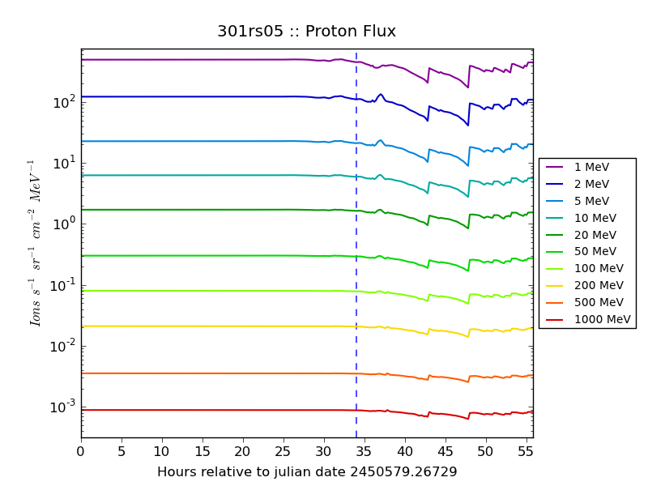
May 1997 :: 5 solar radii

Slide 12
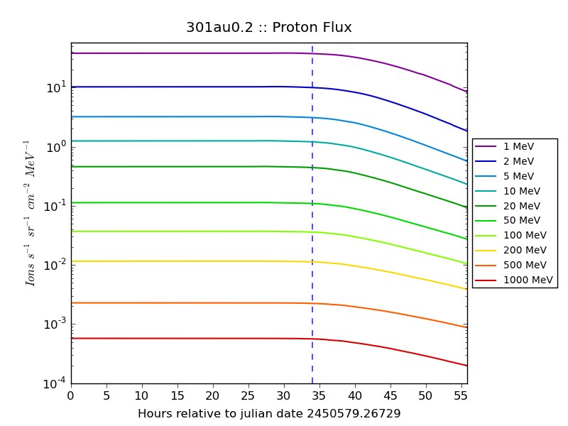
May 1997 :: 0.2 AU

Slide 13
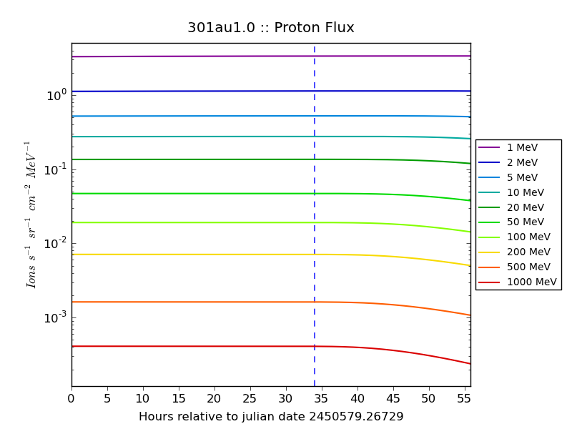
May 1997 :: 1.0 AU

Slide 14
Time moves on…
After running the stronger (forced CME) case and having success with the shock finder we re-ran the weak case.
And…

Slide 15
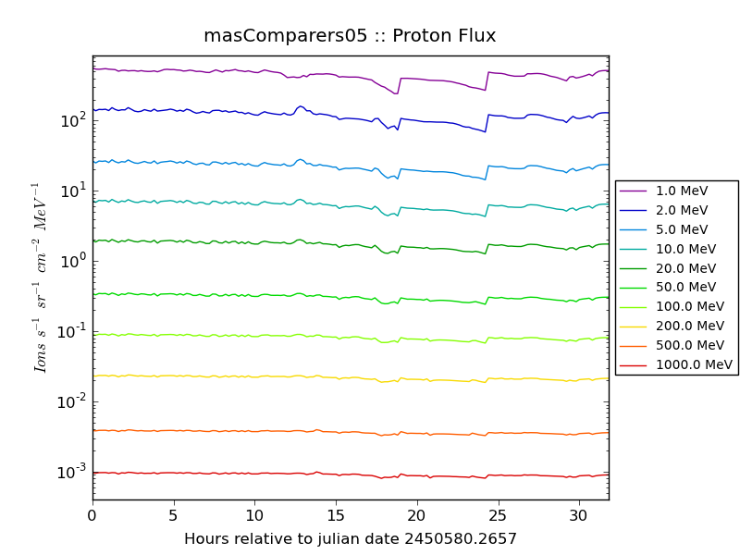
May 1997 :: 5 solar radii NEW AND IMPROVED! Still weak…

Slide 16
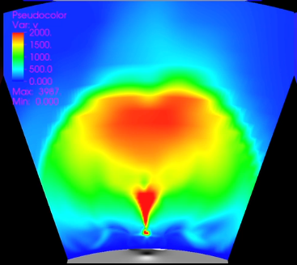
Forced CME
Small, non-uniform time steps. We couple to their tDel to avoid interpolation
in time.
Small burst when the flux rope reconfigures followed by the actual eruption.

Slide 17
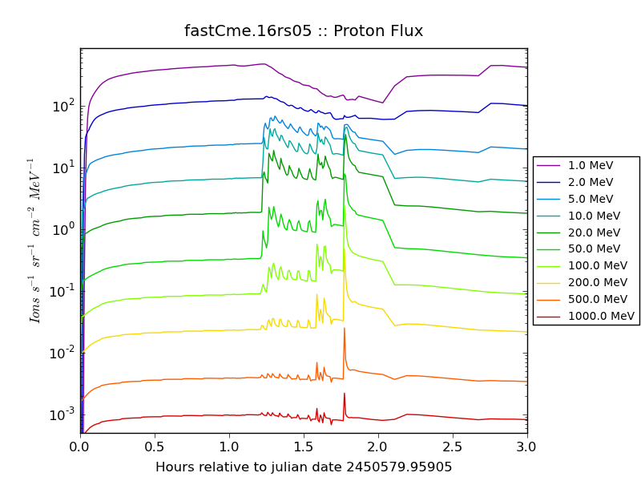
Forced CME :: 5 solar radii
MFP = 0.05 AU @ 1 AU
Scaling with background density, gradient sharpened but no separate MFP for the shock regions.

Slide 18
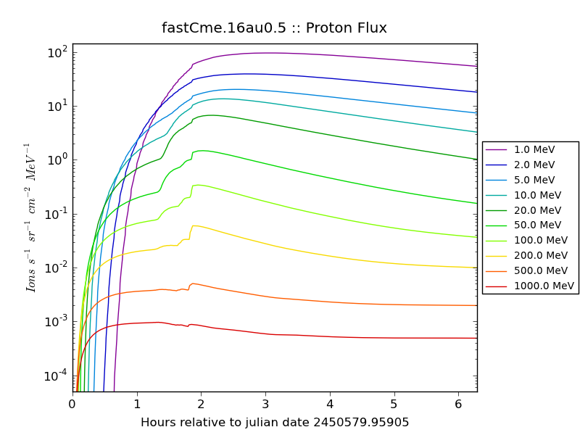
Forced CME :: 0.5 AU
MFP = 0.05 AU @ 1 AU
Scaling with background density, gradient sharpened but no separate MFP for the shock regions.

Slide 19
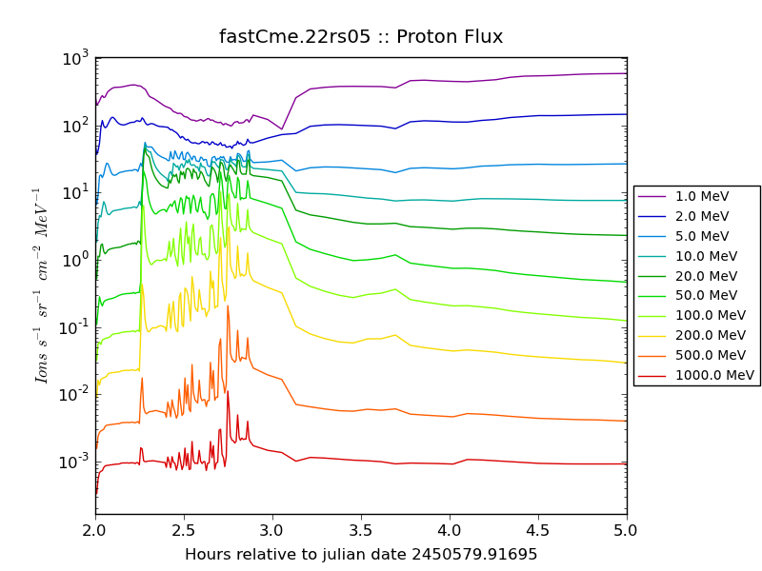
Forced CME :: 5 solar radii
MFP = 0.1 AU @ 1 AU
MFP in shock region = 0.001 AU
Scaling with background density outside of shock region, gradient sharpened, separate MFPs.

Slide 20
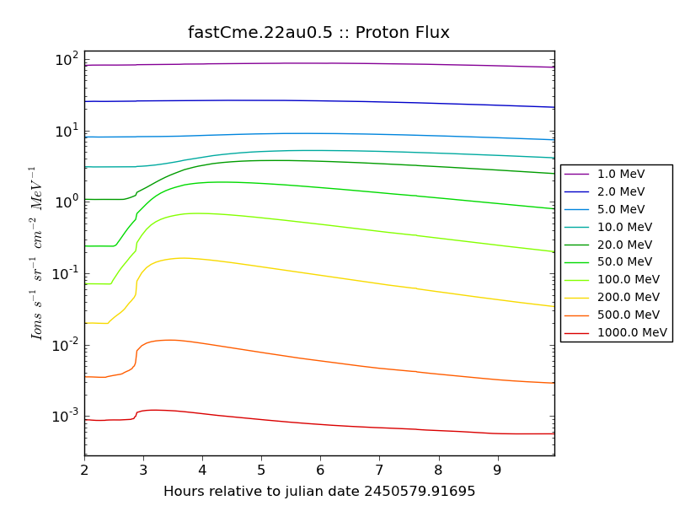
Forced CME :: 0.5 AU
MFP = 0.1 AU @ 1 AU
MFP in shock region = 0.001 AU
Scaling with background density outside of shock region, gradient sharpened, separate MFPs.

Slide 21
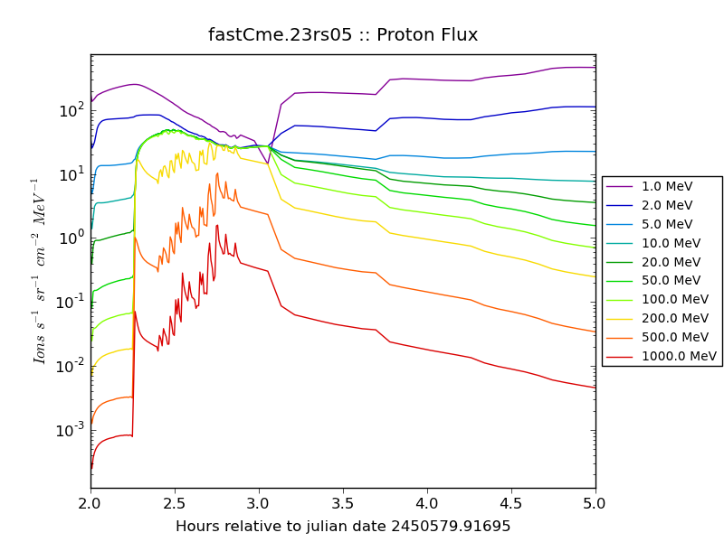
Forced CME :: 5 solar radii
MFP = 0.01 AU @ 1 AU
MFP in shock region = 0.001 AU
Scaling with background density outside of shock region, gradient sharpened, separate MFPs.

Slide 22
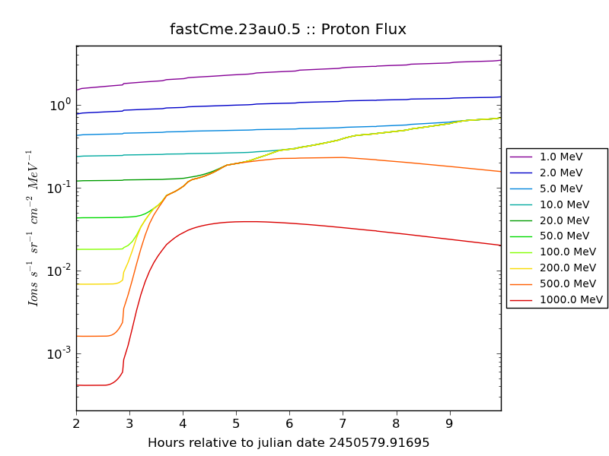
Forced CME :: 0.5 AU
MFP = 0.01 AU @ 1 AU
MFP in shock region = 0.001 AU
Scaling with background density outside of shock region, gradient sharpened, separate MFPs.

Slide 23
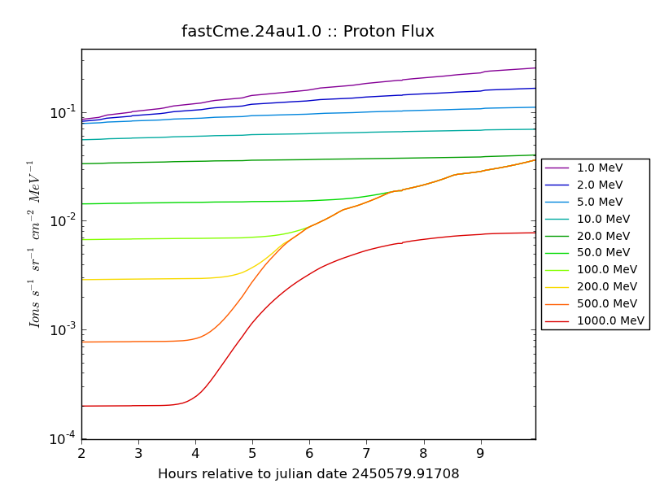
Forced CME :: 1.0 AU
MFP = 0.01 AU @ 1 AU
MFP in shock region = 0.001 AU
Scaling with background density outside of shock region, gradient sharpened, separate MFPs.

Slide 24
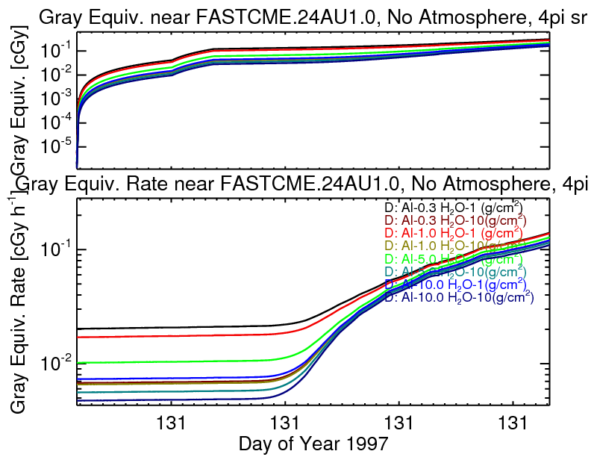
Dose

Slide 25
What is next?
Higher time resolution, longer coupled times, larger domain, etc…
Self-consistent wave generation tied to the MFP in the shock region.
Thank you!

