Slide 1


Modeling Coronal Acceleration of
Solar Energetic Protons
K. A. Kozarev, R. M. Evans, N. A. Schwadron,
M. A. Dayeh, M. Opher, K. E. Korreck
NESSC Meeting, 10/24/2012

Slide 2
In situ SEP fluxes a convolution between:
- changes at acceleration region;
- inteplanetary propagation conditions.
1 AU particle observations – very little information about acceleration region dynamics, efficiency, location, etc.
No in situ observations near the Sun yet, so need models to explore SEP acceleration conditions and locations
Most SEP modeling focused on IP shock acceleration, particle transport beyond 20 solar radii (Zank et al., 2006; Aran et al., 2007).
SEP acceleration lower in the corona largely unexplored (except Sokolov et al., 2004; Kota et al., 2005)
No detailed modeling study of SEP production below 10 R_{s}. Must be addressed.
We performed a study of proton acceleration in a realistic CME

Slide 3
Energetic Particle Radiation Environment Module (EPREM; Schwadron et al., 2010)
Global numerical particle acceleration and transport model; developed at BU, UNH
Considers effects of streaming, convection with the solar wind, adiabatic cooling and heating, pitch-angle focusing and scattering, and stochastic acceleration (based on Kota et al. 2005 formulation)
3D Lagrangian grid of nodes embedded in solar wind flow
Couple EPREM to CME simulation results from 3D MHD coronal model: The Block Adaptive Tree Solar-Wind Roe Upwind Scheme (BATSRUS; Toth et al., 2012) code.
Highly parallelized, includes adaptive mesh refinement
Alfven wave dissipation used to heat steady solar wind
Time-dependent CME through Titov-Demoulin flux rope insertion
Notes:
I did validation, but don’t have time to talk about it now!!!

Slide 4
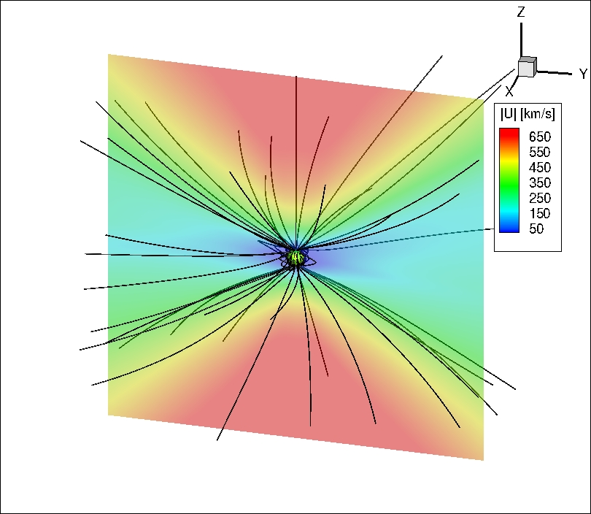
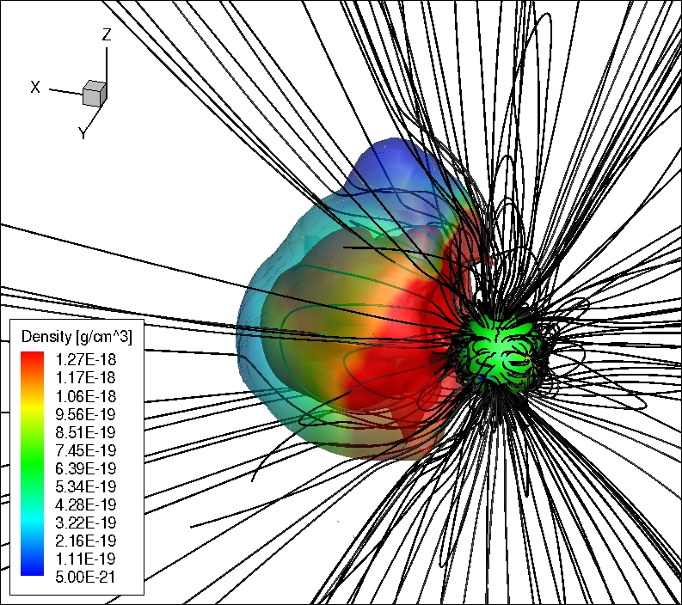
BATSRUS Simulation
t = 60 min
Fast wind
CME Ejecta
Slow wind
Shock
Used results from an MHD simulation of May 13, 2005 CME
Sun
~8 R_{s}

Slide 5
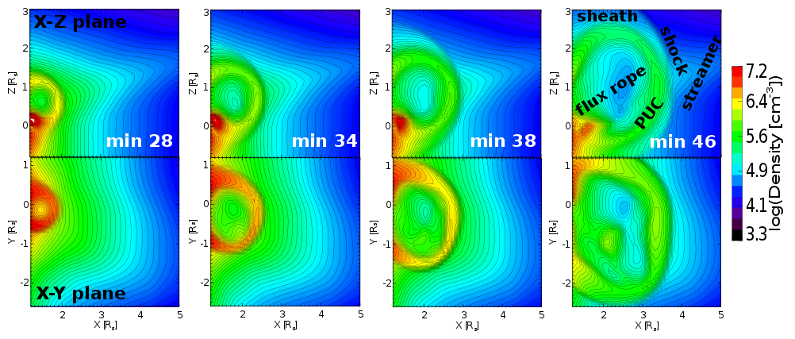
Coronal and CME Density: Inner Region
X-Z and X-Y plane density contours over 18 minutes in inner region
CME mostly inside a coronal streamer (a magnetically confined region of dense coronal plasma)
-CME retained original shape most of the time
-In last snapshot, CME exits dense part of streamer; overexpands in –Y direction
-Pile Up Compression (PUC) region (Das et al. 2011) separates from shock sheath

Slide 6
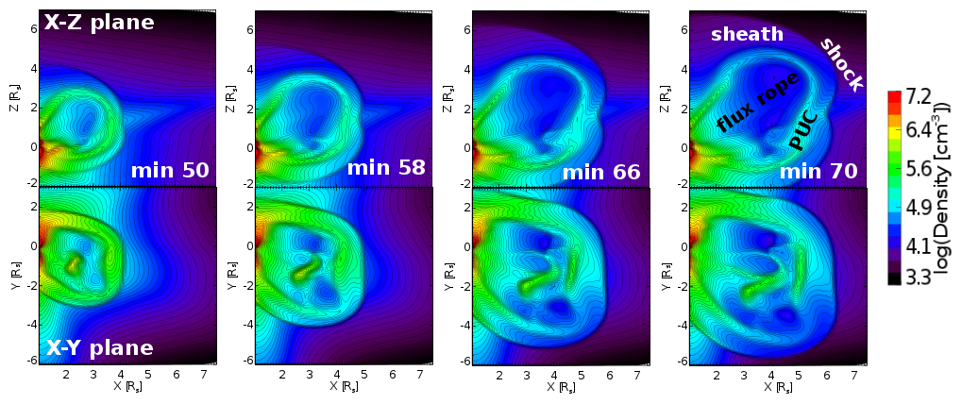
Coronal and CME Density: Outer Region
X-Z and X-Y slices of density evolution over 20 minutes in outer region
Expansion continues preferentially in +Z and –Y directions
Sheath is distinct from PUC
PUC wrapped closely around flux rope.

Slide 7
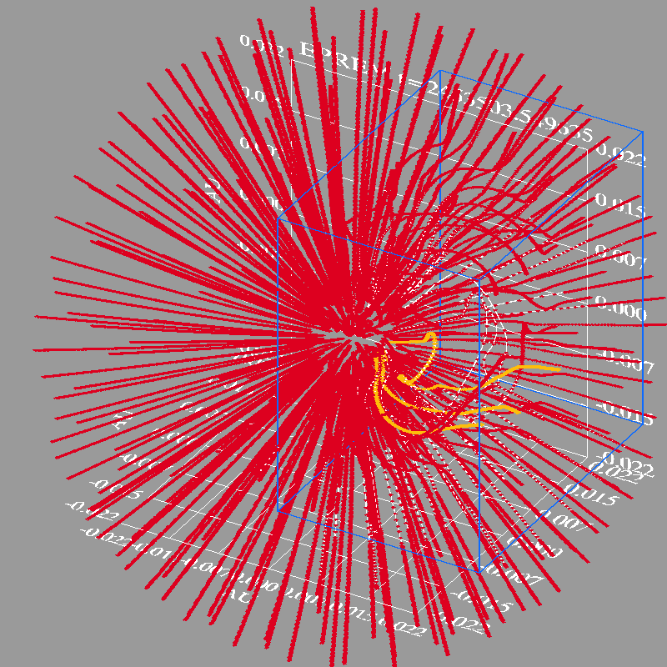
Coupling EPREM to BATSRUS
MHD box
Every ~2 min extract a box of regularly gridded MHD cells surrounding the CME.
MHD information at EPREM nodes updated by interpolation in 3D
Field lines distorted by evolving CME

Slide 8
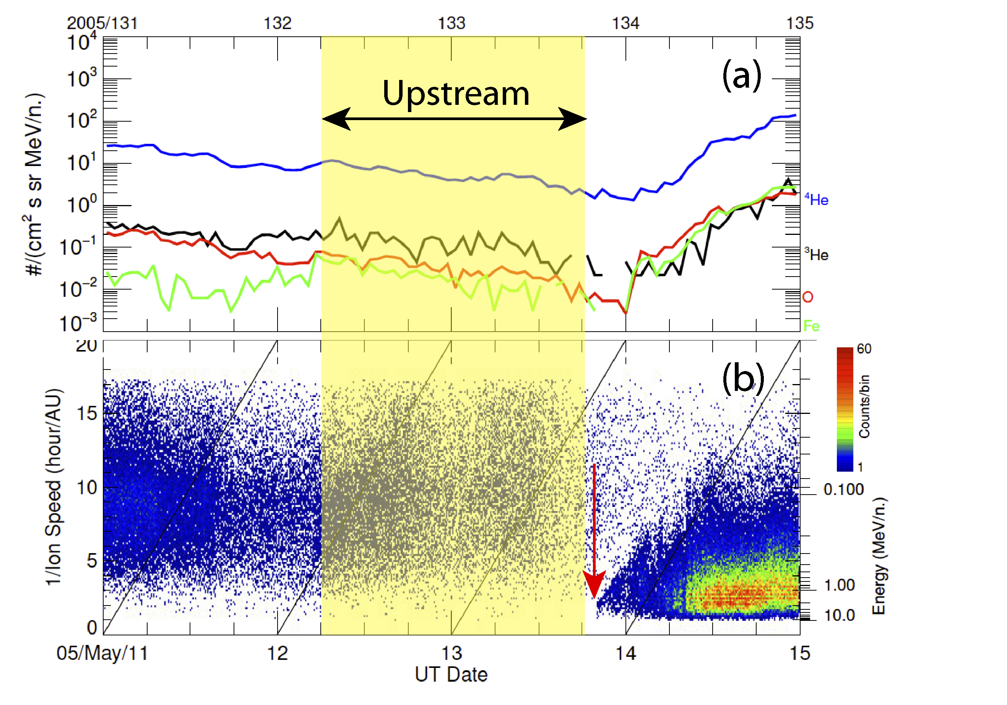
Suprathermal source population
-Used quiet time Helium observations at 1 AU 1.5 days before May 13 event
Obtained spectrum between 0.1 and 1.0 MeV/nuc
Scaled to 1.8 R_{s} assuming 1/r² flux dependence
Scaled to hydrogen spectrum assuming 10% He abundance
Beyond 1.0 MeV assumed exponential rollover of spectrum (very steep decay of the fluxes)

Slide 9
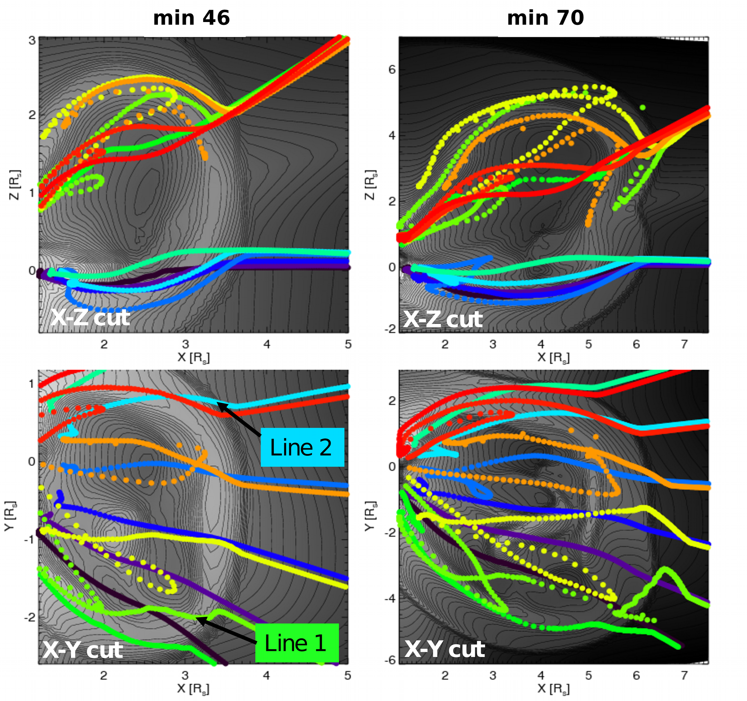
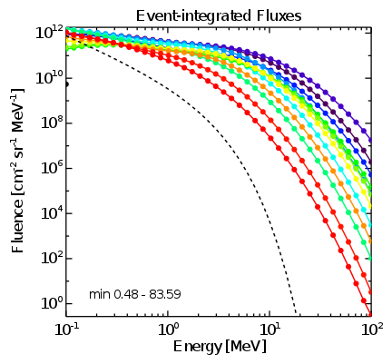
Look at EPREM field lines distorted by CME
Event-integrated Fluxes at 8 R_{s}
Line 1
Source
spectrum
Density contours
Line 2
Chose two lines to study: one with most acceleration, one with least
Call them Line 1 and Line 2

Slide 10
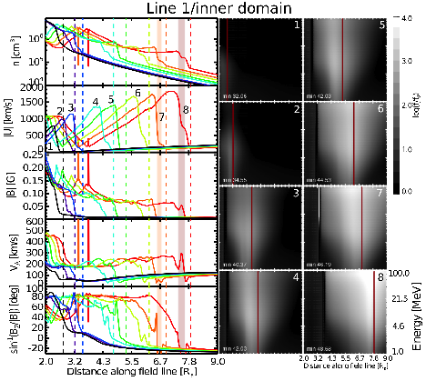
Line 1 INNER REGION
Significant increase of f enhancement after min 40 (steps 4-8)
Largest enhancements in sheath behind shock
About 4 orders of magnitude f enhancement at largest energies

Slide 11
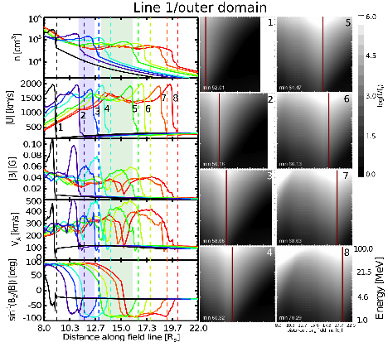
Line 1 OUTER REGION
-Efficient acceleration continues
-f enhancement up to 6 orders of magnitude
-More enhancement behind the shock due to compressive acceleration
-PUC becomes wider

Slide 12
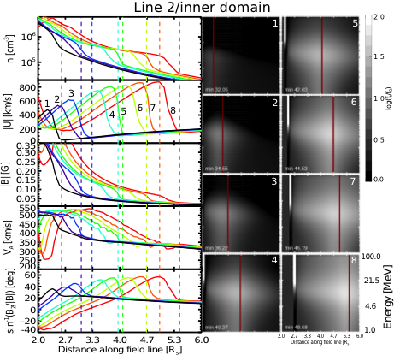
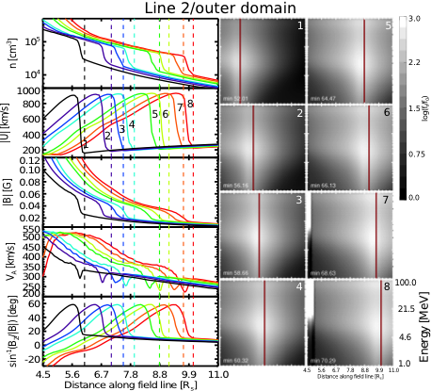
Gradual acceleration along Line 2
Line 2 INNER REGION
Line 2 OUTER REGION
Notes:
-Lower speeds along Line 2
-Enhancements up to 3 orders of magnitude
-Acceleration most efficient around ~20 MeV
-More gradual enhancement of fluxes, slower increase to higher energies

Slide 13
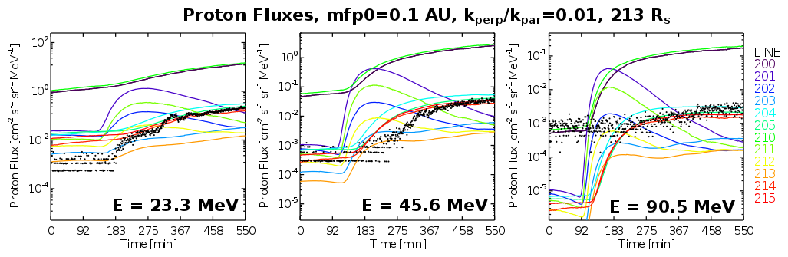
Propagating protons from coronal simulation to 1 AU
-Used steady state solar wind model
-Compared output to 2 hr flux averages from SOHO/ERNE
23 MeV
18.7 MeV
Observations
Results:
-Variation in coronal fluxes retained
-Reasonable agreement to in situ observations!
-Next, extend BATSRUS/EPREM sim to 1 AU

Slide 14
Conclusions
First detailed modeling study of CME proton acceleration in solar corona
Shape and dynamics of CME governed by coronal conditions
Different acceleration on field lines on varying CME dynamics
Found strong acceleration in CME PUC region
Fluxes near 1 AU approach observations

Slide 15
Thank You!

Slide 16
Extra Slides

Slide 17
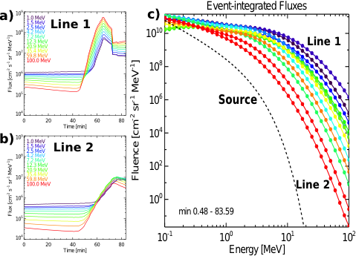
Fluxes at 8 R_{s}

Slide 18
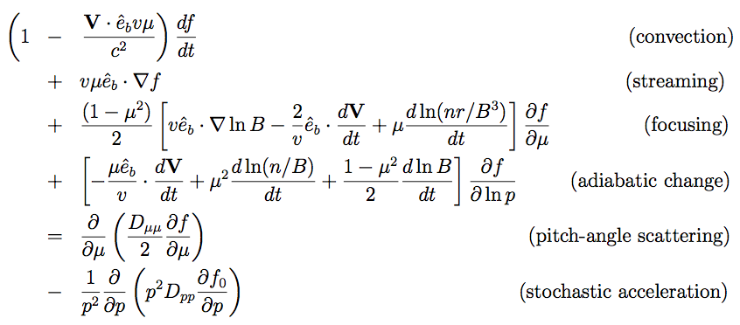





EPREM Transport Equations
Parallel Transport equation
Perpendicular Transport equation

Slide 19
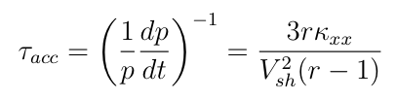




Coronal Waves
Change in momentum in time dt due to DSA acceleration is
Particle acceleration timescale
(Zank et al., 2006)
Diffusion coefficient
θ_{BN} is shock normal-field angle, λ|| is scattering mean free path, r is density jump

Slide 20
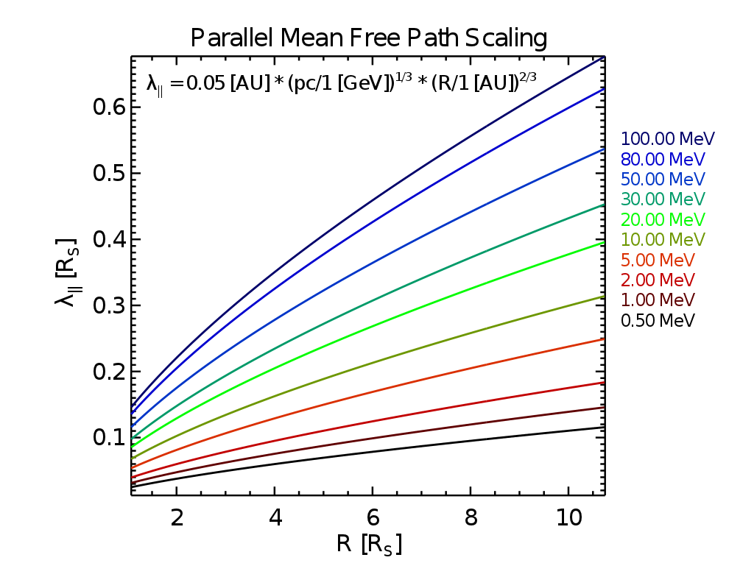
The proton mean free path
After Li et al. (2003) and Verkhoglyadova et al. (2008)

Slide 21
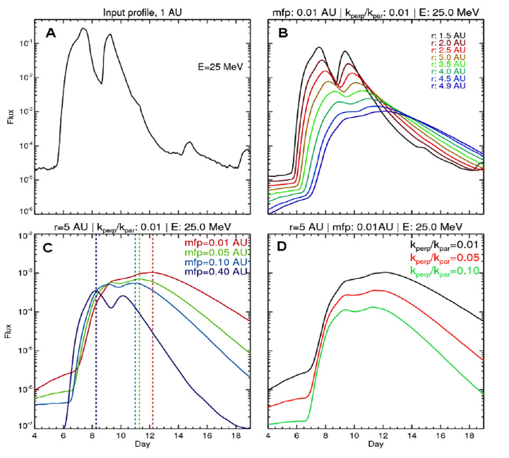
Illustrating Transport Effects
A. Source profile at 1 AU
B. Larger radial distance = more spread, lower max fluxes
C. Longer mean free path (less scattering) = earlier onset, faster decay
D. More perpendicular diffusion = lower fluxes

Slide 22
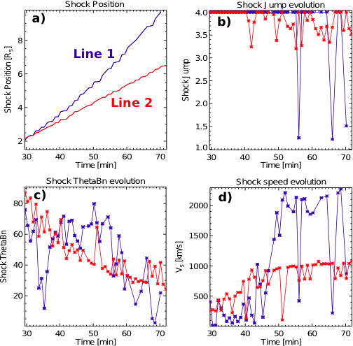
Follow Shock Parameters along Lines 1 and 2
(a) Shock location reaches much farther along Line 1, accelerates around min 40
(b) Strong shock along both lines, slightly weaker along Line 2
(c) Shock becoming more parallel with time along Line 2, irregular behavior along Line 1
(d) Shock speed increases with time, shock becomes twice as fast along Line 1 after min 45

Slide 23
Structure of study
Run EPREM+BATSRUS model: compute proton distributions along different field lines
Split coronal domain into two regions:
1) inner - CME shock nose traveled between 2 and 4 R_{s}
2) outer - CME shock nose traveled between 4 and 8 Rs
Study CME evolution to determine conditions for acceleration of protons
Explore proton acceleration and relate to plasma evolution

