Slide 1
The Heliosphere is Not Round
N. A. Schwadron and M. Bzowski

Slide 2
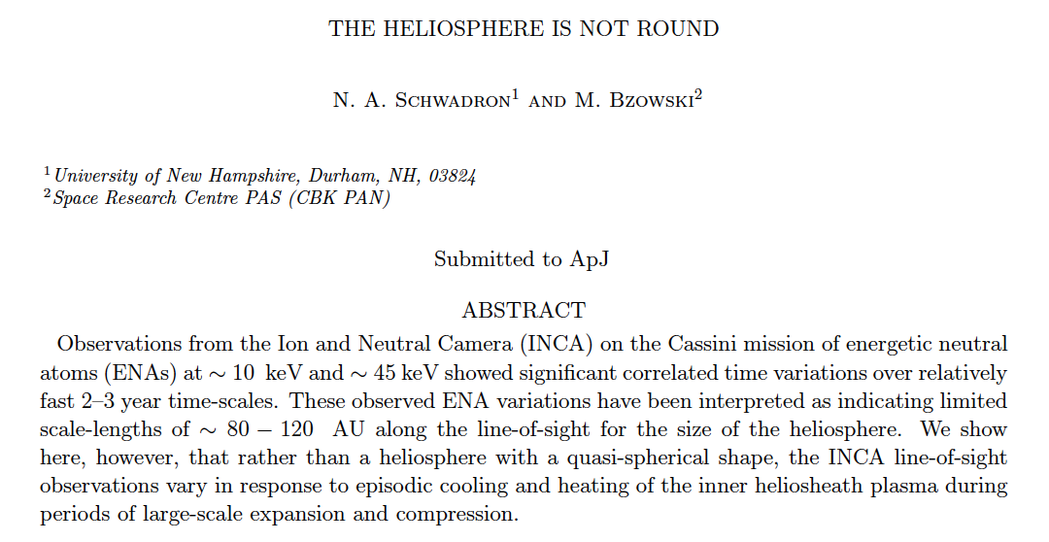
Heliosphere Is Not Round
Time variation driven by Expansion/Cooling and Compression/Heating
ApJ, 862, July, 2018

Slide 3
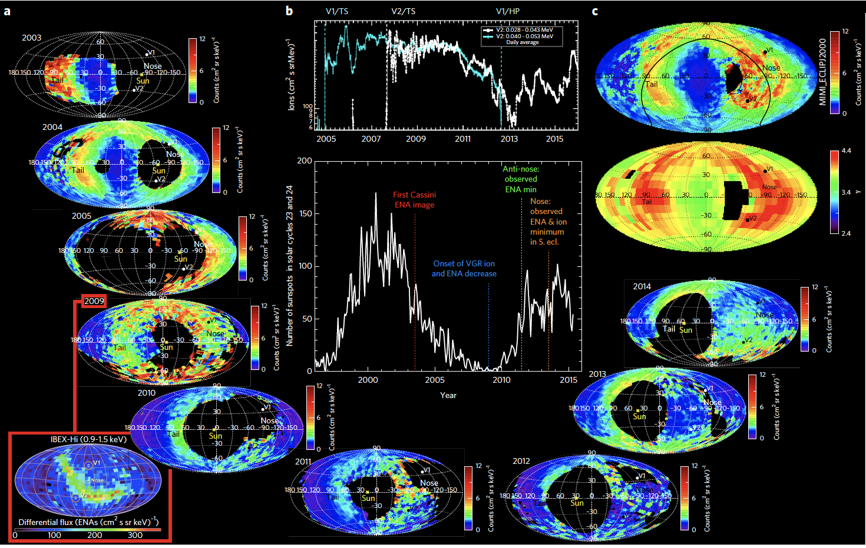
Dialynas et al., 2017

Slide 4
Key arguments
2-3 year time variations
Scale length associated with plasma flow
  ~80 to 120 AU
Charge-exchange scales 200 AU at 45 keV with flow speed of 100 km/s
Line-of-sight must be limited!

Slide 5
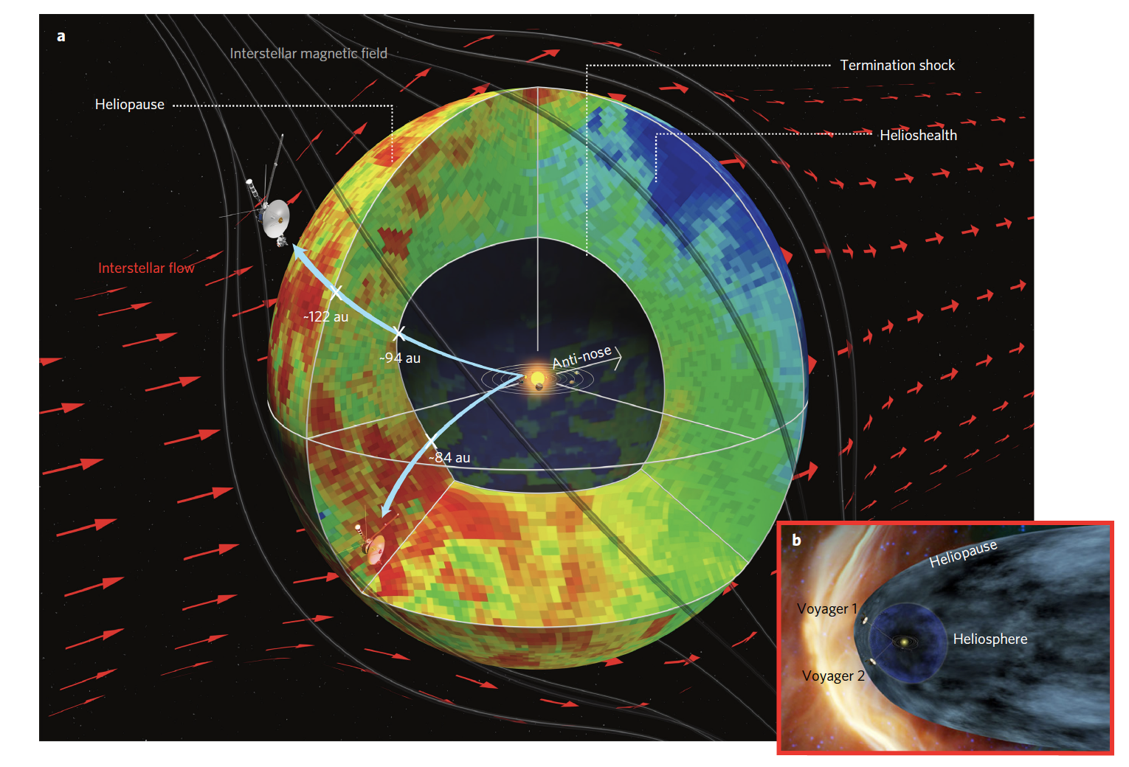
Heliosphere looks semi-spherical
Dialynas et al. 2017

Slide 6
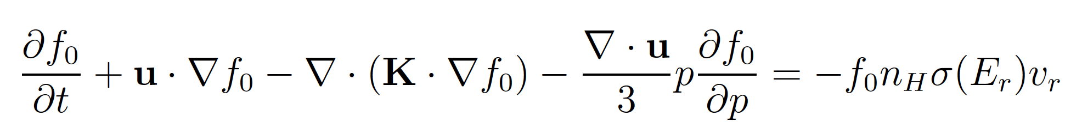
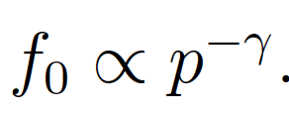
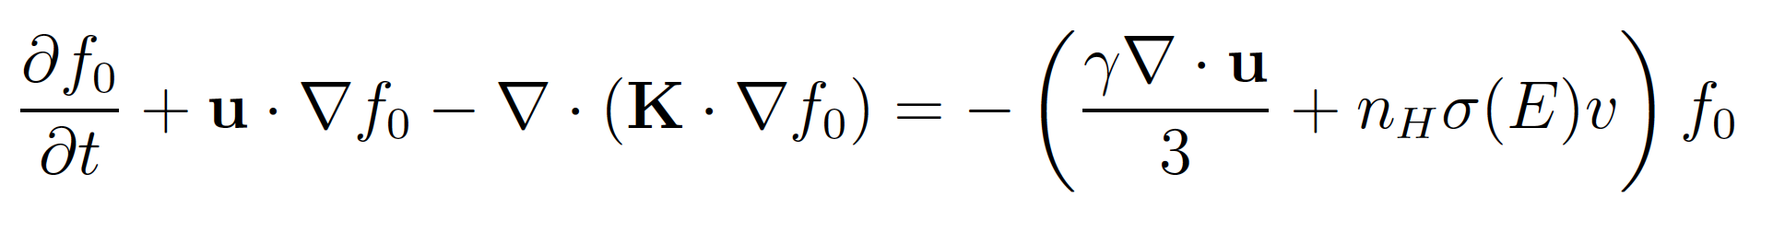
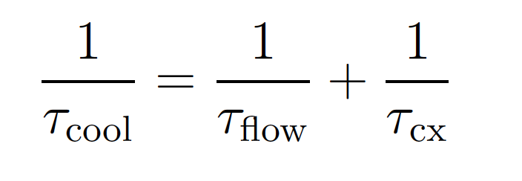
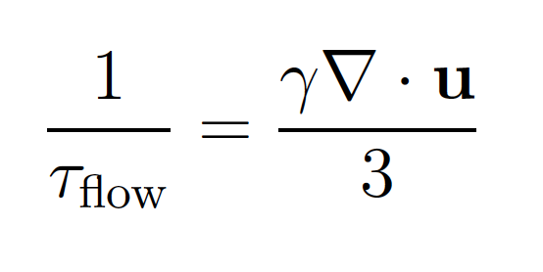
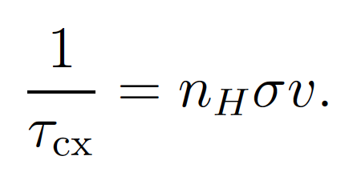
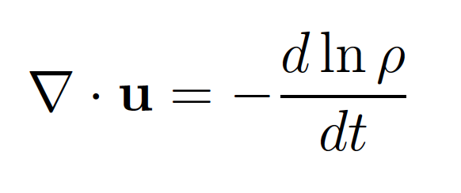

Generalized Cooling Time & Scale
Schwadron and Bzowski, The Heliosphere is not round, ApJ, 2018

Slide 7
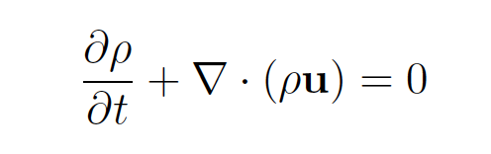
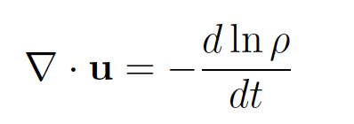
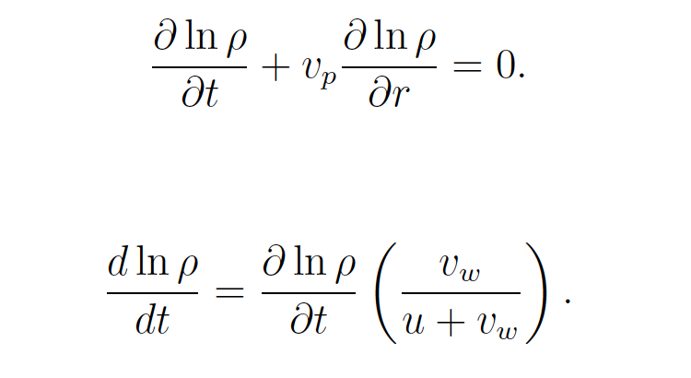
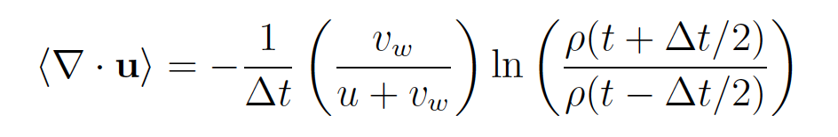
Solving for plasma divergence

Slide 8
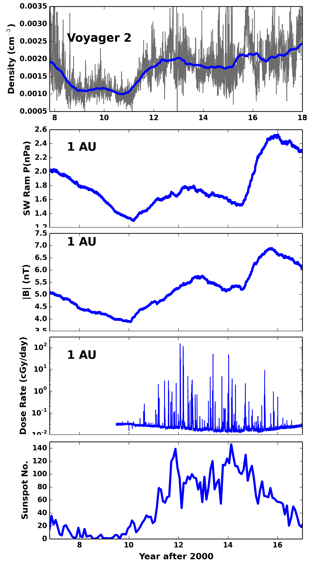
Heliosheath Expansion and
Contraction
Solar Wind Ram pressure change drives expansion and contraction in Heliosheath
Declining ram pressure leads to expansion of Heliosheath
Increasing ram pressure leads to compression of Heliosheath
Schwadron and Bzowski, The Heliosphere is not round, ApJ, 862, 2018

Slide 9
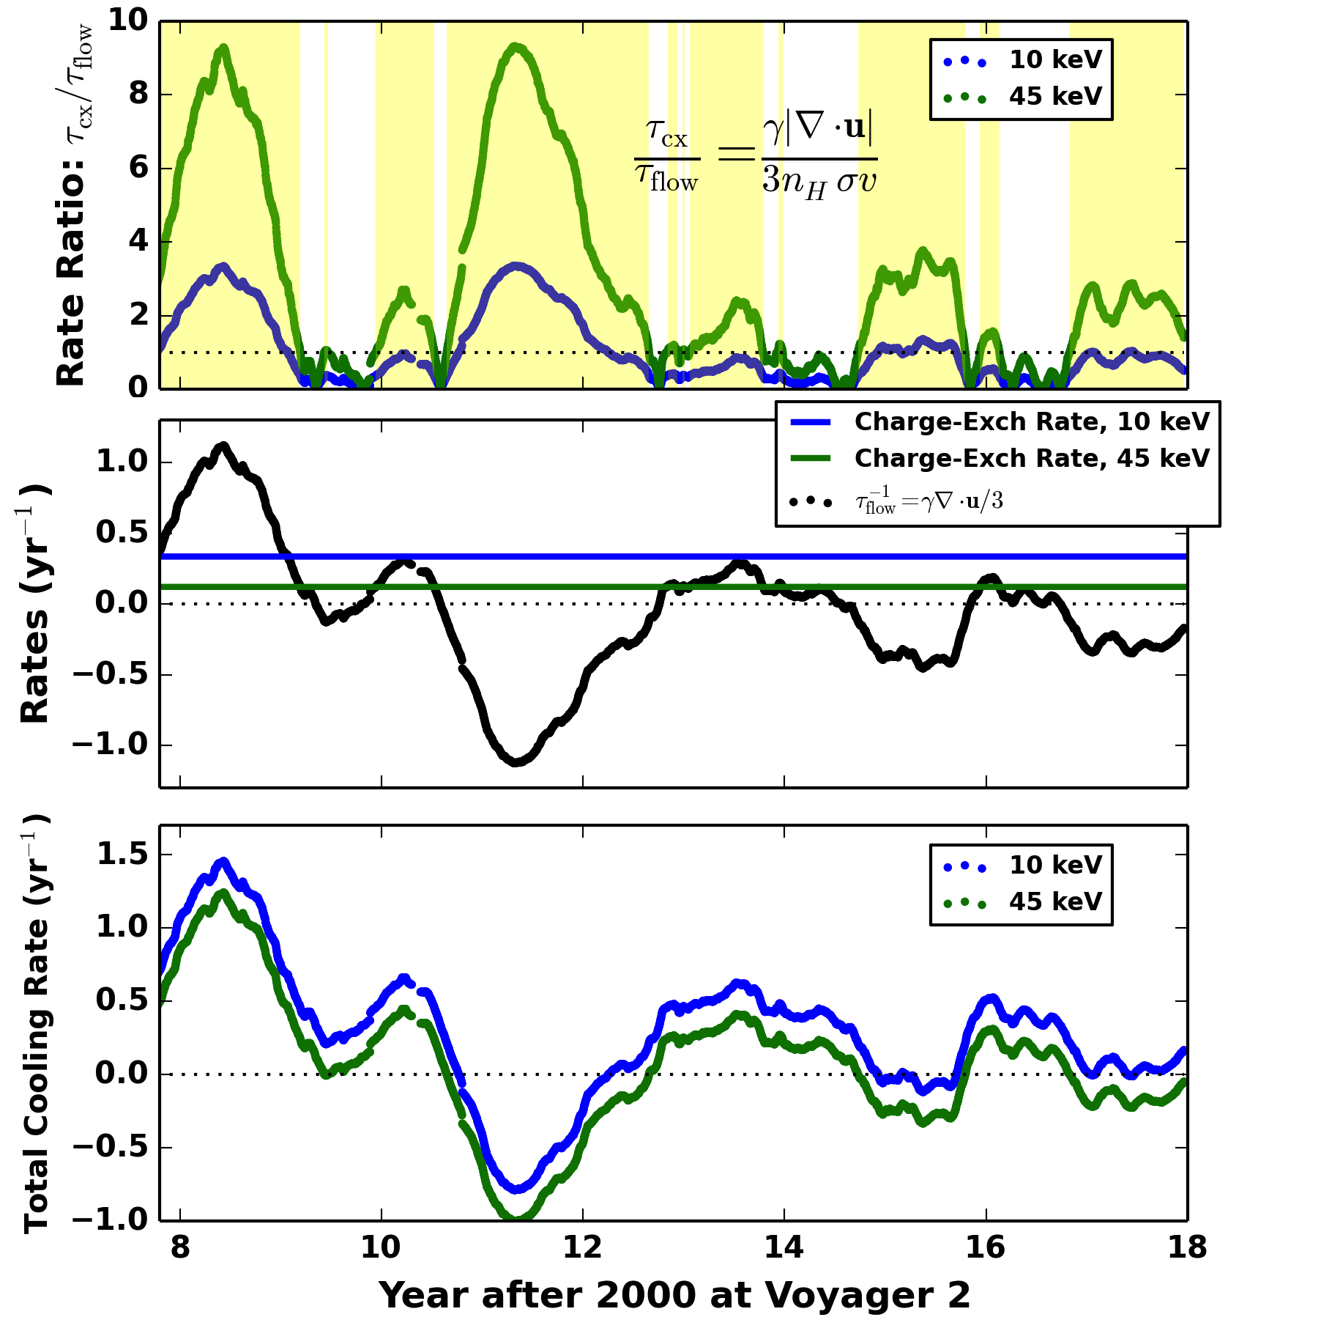
Note the dominance of flow compression for cooling/hearing!
Driven partly by expansion/compression of Heliosheath before 2012
Schwadron and Bzowski, ApJ 2018

Slide 10
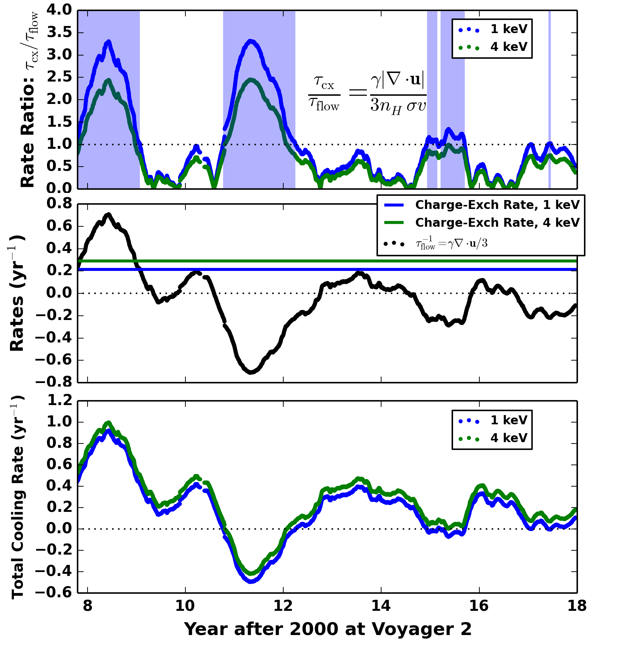
Lower IBEX energies
Stronger effects due to charge-exchange
Schwadron et al., ApJS, Submitted, 2018

Slide 11
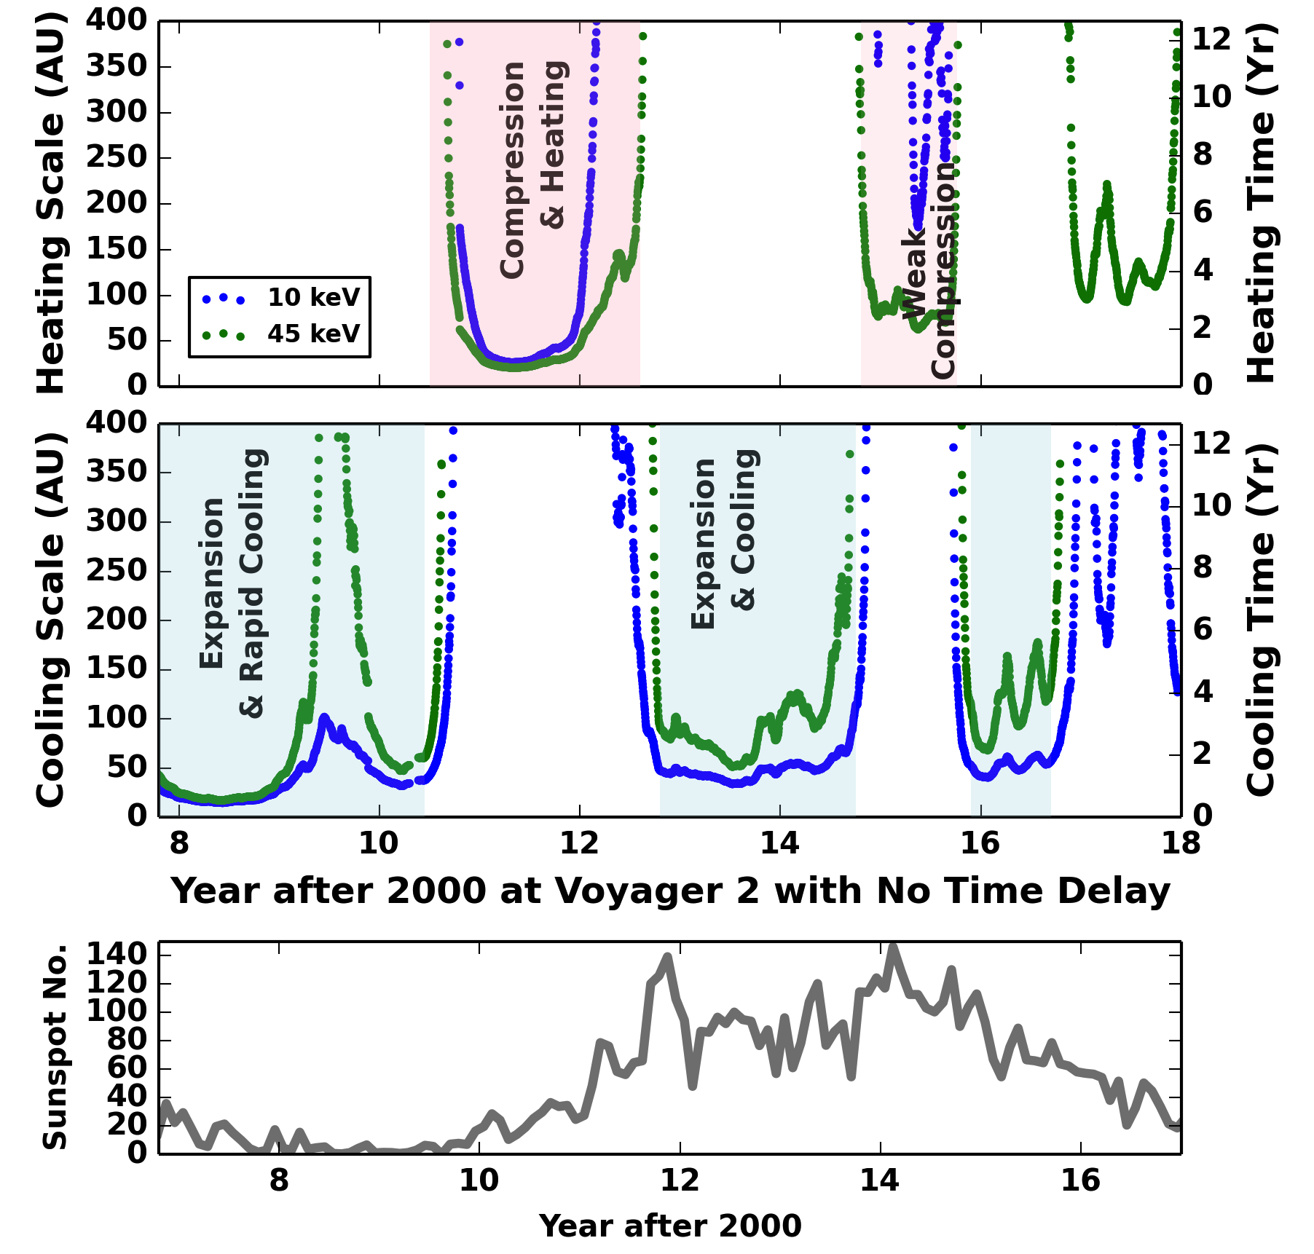
Note dominance of expansion/cooling through the end of cycle 23
Compression/heating beginning of cycle 24
Schwadron and Bzowski, 2018

Slide 12
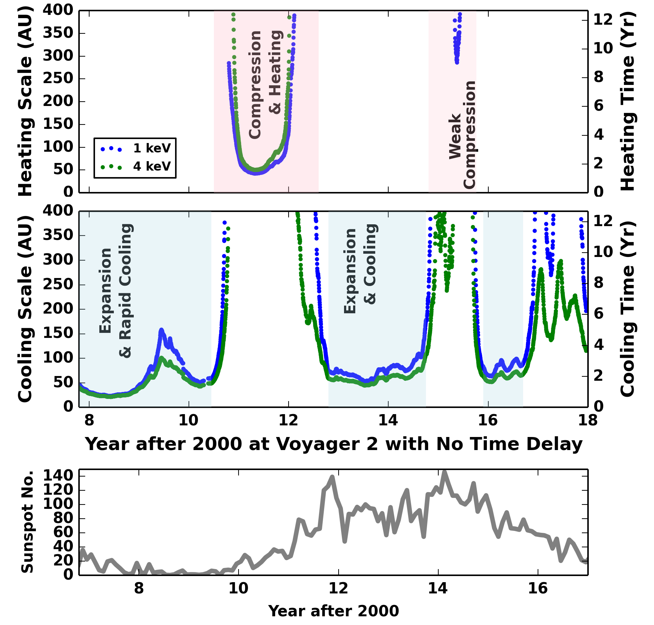
Similar trends at IBEX energies but again stronger effects due to charge-exchange
Schwadron et al..
Submitted, 2018

Slide 13
Heliosheath Reservoir (1/2)
Given parallel scattering mean free path ~20 AU, diffusion scales ~60 AU at 10 keV, ~90 AU at 45 keV
Perpendicular diffusion scales 15 AU (10 keV) to 20 AU (45 keV)
Driving by solar wind coordinated across latitudes [Sokol et al., 2015)
Expect collective response by energetic particles

Slide 14
Heliosheath Reservoir
Time delay due propagation of expansion or compression waves
  Forward propagation through heliosheath ~0.5 year [Schwadron & McComas, 2017]
  Reverse propagation ~ 1.4 year (30 AU scale, 100 km/s flow speed and ~ 200 km/s wave speed)
  Time delay >~ 2 year
Observe period of cooling ending in 2010.7
Expect minimum in energetic particles ~2012.7, as observed by V1

Slide 15
Conclusions
Cooling or Heating scale typically much smaller than charge-exchange scale
Expansion and Compression of the plasma leads to rapid cooling and heating timescales
We can easily explain 2-3 year time-variations in the heliosheath
Collective response by energetic particles with ~ 2 year time delay near nose

Slide 16
Central Conclusion
Do the rapid 2–3 year declines and recoveries in suprathermal and energetic particle ENA fluxes place an observational limit on the size of the heliosphere?
No
Plasma expansion and compression in the heliosheath have a large influence on the time-scale associated with cooling (or heating) of the heliosheath plasma.
Limits the scale-length associated with cooling or heating to 20 – 100 AU.
No contradiction between the observation by Cassini/INCA of rapid 2–3 year decline and recovery of ENA fluxes (10 – 45 keV) (Dialynas et al. 2017) and the evidence of large-scale heliospheric structure (e.g., Zirnstein et al. 2016a), which includes evidence of a heliospheric tail (e.g., McComas et al. 2013).

