Slide 1

CMEs, Current Sheets and Disconnection Events
David F. Webb
Institute for Scientific Research, Boston College
NESSC: Simulations and Obs. of CMEs, SEPs & ARs
BU, Boston
11 February 2013

Slide 2
Role of CMEs in Field Line
Reconnection & Current Sheets
CMEs involve expulsion of significant amounts of mass and magnetic flux into heliosphere
- Implies continuous buildup of the net interplanetary magnetic flux (IMF)
But over time IMF varies with solar cycle, open flux varies ~50%.
- So a buildup is not observed
  - Thus, reconnection/disconnection of the flux near Sun seems required
Field line reconnection in wake of CMEs is a fundamental aspect of some magnetically driven eruptive flare/CME models.
- Such a “standard” model features a growing hot loop arcade beneath a rising X-type
neutral point connected to the retreating CME
- Recent versions → rising CME & hot arcade connected by stretched current sheet (CS)
Candidate disconnection events & CSs identified observationally:
- In lower atmosphere → hot arcades with cusps, looptop HXR sources, XUV rays, inflows
and downflows
- In corona near Sun → in WL as narrow rays trailing outward-moving CMEs and in UV
spectra as narrow bright, hot features
- In inner heliosphere (STEREO) as U-shaped loops and voids
  2-D and 3-D models developed involving Petschek reconnection, MHD of CME evolution, numerical reconnection, and steady vs bursty reconnection in CS (will not discuss here)

Slide 3
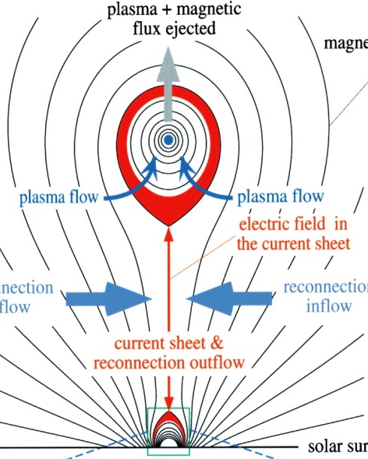
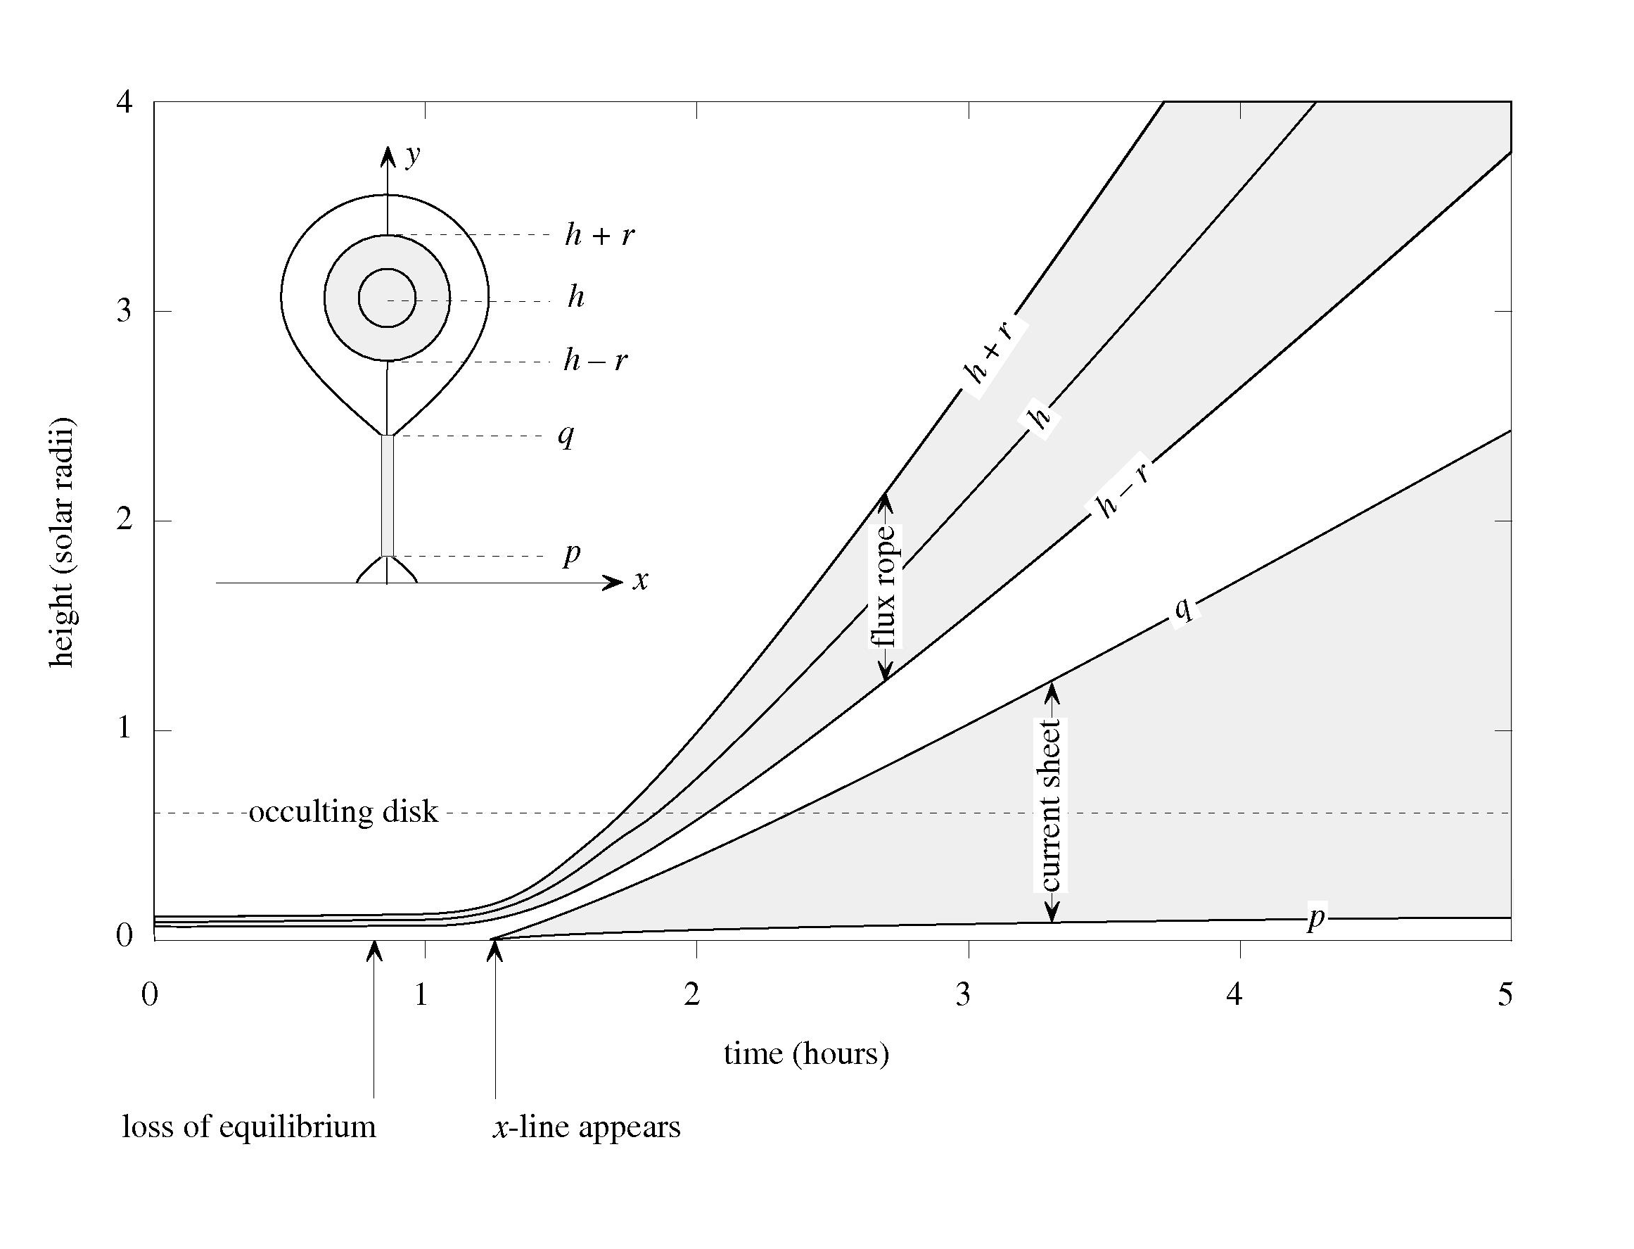
Observations of CME-Flux Ropes
with Evidence of Current Sheets
Look for concave-outward structure at base of CME
- In study with SMM coronagraph, ~half of C-O CMEs trailed by
narrow, transient rays.
- ~10% of all CMEs had rays → Evidence of field line reconnection/disconnection?
- Catalog of LASCO CME/rays
- Compared with UVCS and MLSO obs.
CMEs with rays now observed in corona in white light by coronagraphs, and near surface in EUV, soft and hard X-ray wavelengths.
- Recent imaging data: SOHO, STEREO, Hinode, SDO
- Spectral data from SOHO CDS, Hinode EIS, SDO EVE
Data can be compared with models for height,
thickness, speed as f(time).
Next, some examples
Lin & Forbes (2000) model

Slide 4
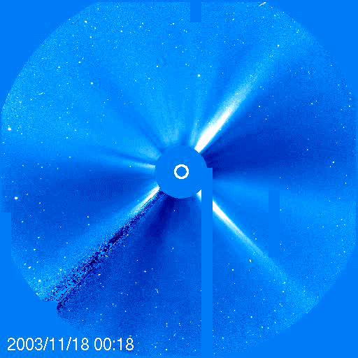
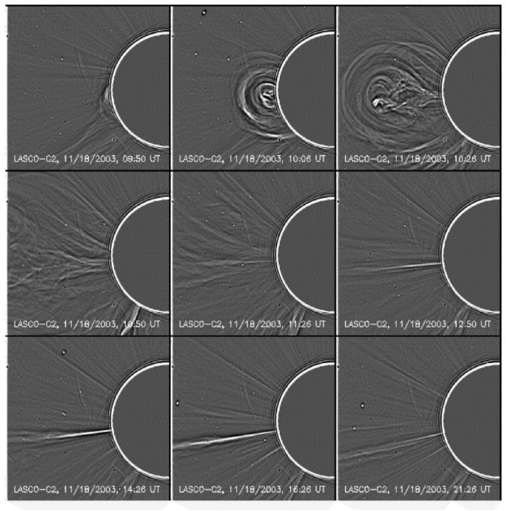
Very fast CME/FR/Ray-Current Sheet: 18-20 Nov 2003 Event
(Lin et al., ApJ, 2005)
Shows WL Ray Characteristics:
Ray forms at base of FR
Blobs move along ray →
bursty reconnection
Ray moves in PA with time

Slide 5
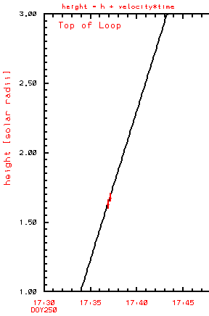
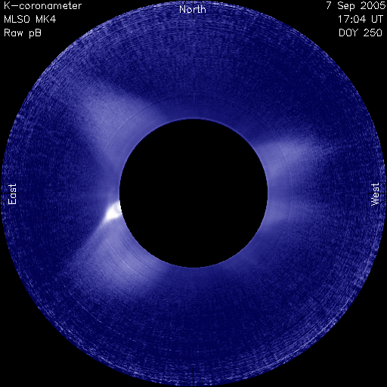
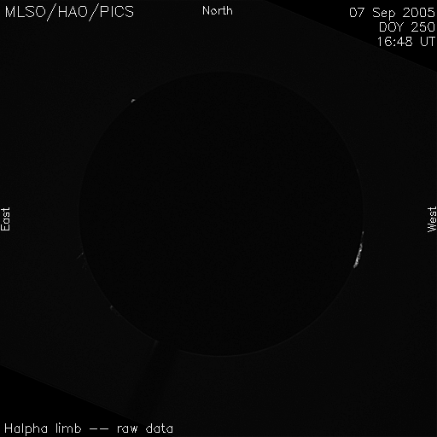
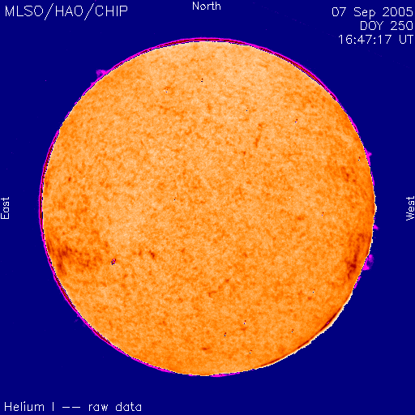
7 Sept. 2005 → No SOHO Data;
MLSO Observations only
2490
km/s!
MK4 pB Corona
Hα limb
PICS
He 10830A
CHIP

Slide 6
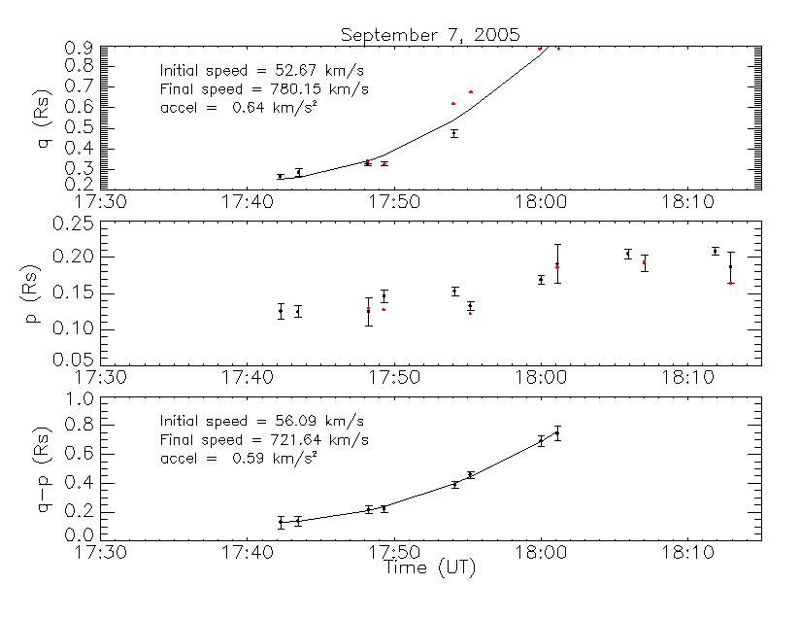
Results for Sept. 2005 CS
- Narrowest ray width is ~0.05 Rs (37,000 km)
- No evidence for outward motion of the X-point, or diffusion region.
- Motion of CS top (q) is meas. from 0.27 – 0.89 Rs and fit with a polynomial with final speed 780 km/s and acceleration of 0.64 km/s²
- Over this same time period the CS length (q - p) grows from 0.13 – 0.74 Rs; avg. growth rate = 377 km/s
Paper in preparation: Ling, Webb, Burkepile, Cliver (2013)

Slide 7
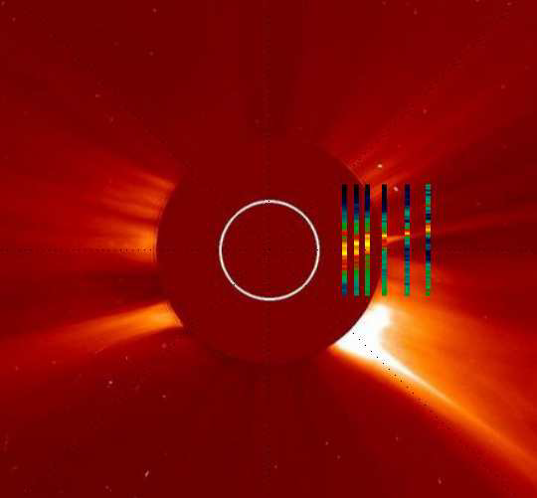
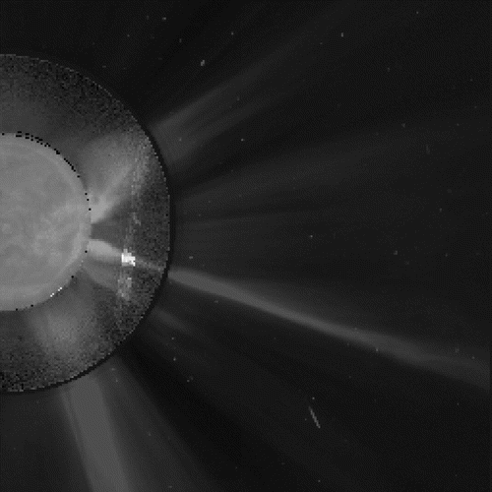
Current Sheets in UV Spectra
1998/03/23 Ciaravella et al 2002
2002/01/08 Ko et al 2003
2002/04/21 Raymond et al 2003 & Lee et al 2006
2002/11/26 Bemporad et al 2006
2003/11/04 Ciaravella & Raymond 2008
2003/06/02 Schettino et al 2009
[ Fe XVIII ] 975 Å narrow feature
18:06:05 UT
20:06:05 UT
EIT 23:48 UT
MK4 23:48 UT
C2 23:54 UT
21:30:08 UT
22:30:06 UT
CS
LASCO and UVCS images for WL ray observed on 22 May 1998. UVCS slit images in O VI.

Slide 8
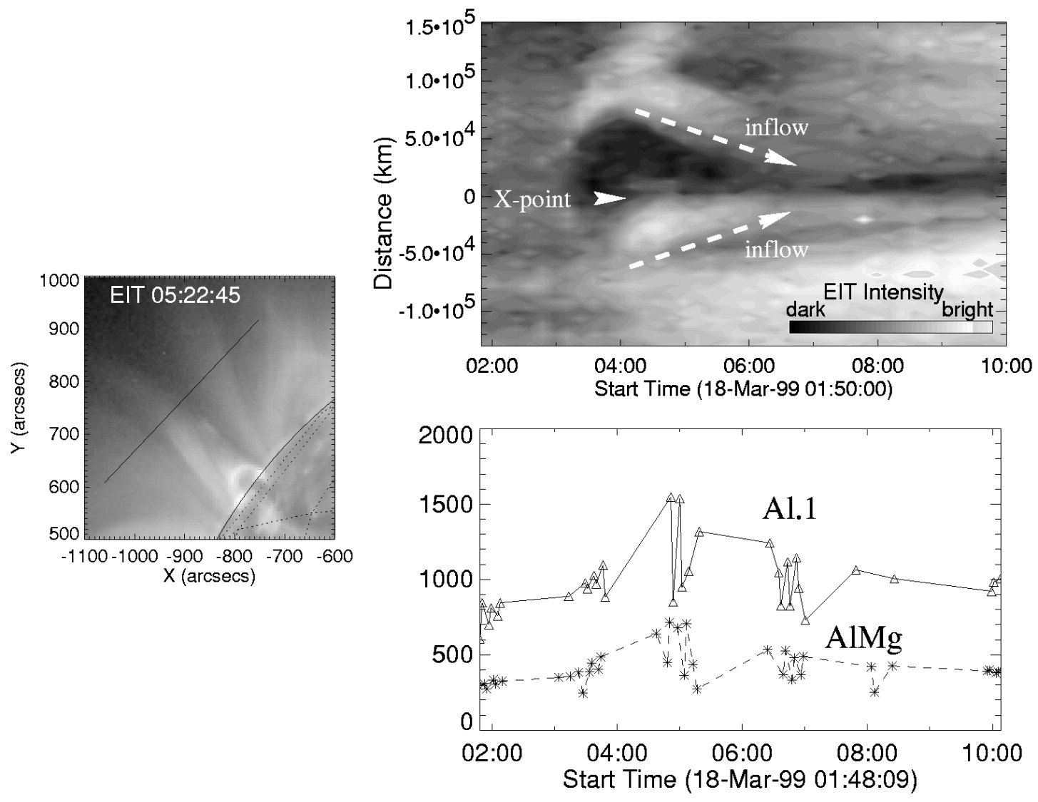
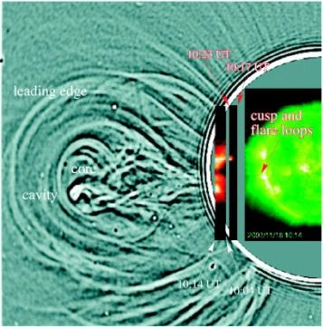
Measured Inflow Velocities – EUV
18 March 1999 – Yokoyama et al. (2001)
Time variation of EIT intensity across X-point region → line in left panel.
Inflow velocity
~5 km/sec
at ~120,000 km
18 November 2003 Event
EIT – UVCS Lyα – LASCO
Lin et al., ApJ (2003)
Inflow velocities 10 – 105 km/s
at 1.7 Rs

Slide 9
Comparison of Models (CS characterized by Petshek-like reconnection geometry with diffusion region located at heliocentric distance R_{DR}) & Observations (excess density; Vrsnak et al., 2009)
CS model results
for R₀=1.1, 1.3, 1.5
model corona
LASCO mass
maps (avg)
UVCS:
Ciaravella et al., ApJ
(2002)
Ko et al., ApJ (2003)
Bemporad et al., ApJ
(2006)
x corona
Bemporad et al. (2006)
polarization brightness, ray
Poletto et al., AG (2008)
LASCO:
Ko et al., ApJ (2003)
polarization brightness, corona
Poletto et al. (2008)

Slide 10
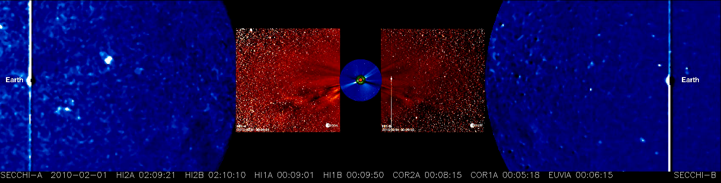
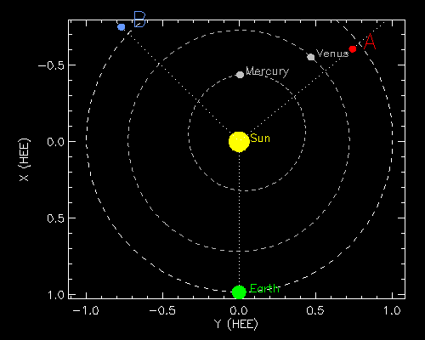
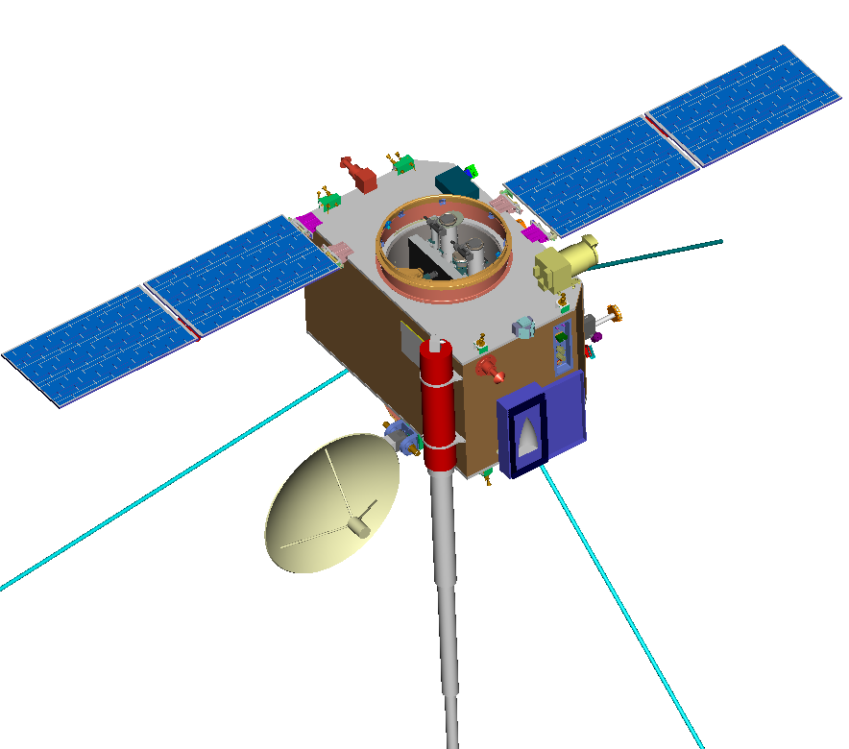
Imaging the Heliosphere with STEREO
White Light Observations
SCIP
Plastic
HI
SWAVES
Boom (3x)
IMPACT
Boom

Slide 11
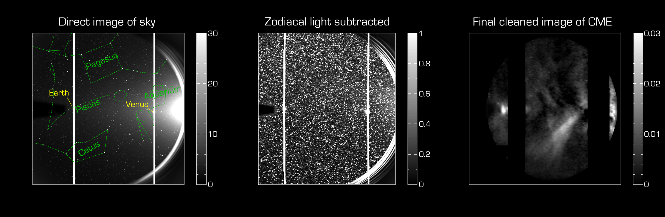
The Difficulty of Heliospheric Imaging
• Thomson-scattered light at 45° → 1000 times fainter than background.
• Starfield identification and removal is a very challenging task.
Successful new processing technique: DeForest et al., ApJ (2012)

Slide 12
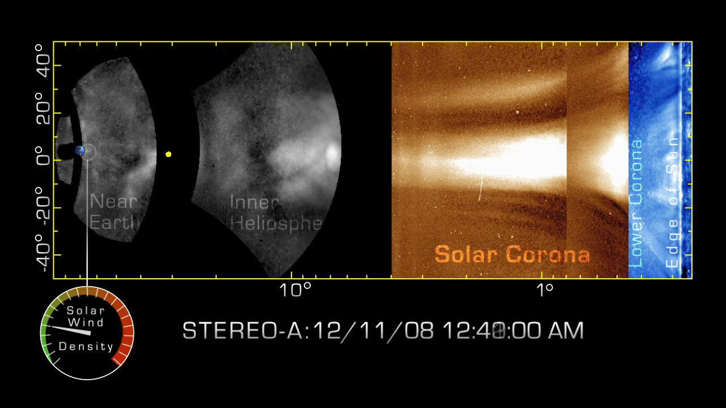
SECCHI – 2011 Processing Developments

Slide 13
Estimating the Amount of Open Magnetic Field Flux Carried Away by CMEs
Use V-type features in SECCHI/HI-2 as a sign of magnetic disconnection
Estimate entrained magnetic field by balancing magnetic tension force to drag:
  0.08 G at 7 Rs.
Over a 36-day period:
  disconnection rate of unsigned flux
  6 X10²¹ Mx/yr.
  corresponds to a change in the radial IMF at Earth of 0.2 nT/yr.
  about 10% of observed rate of change of open field at 1 AU (Schwadron et al., ApJ, 2010)
→ Therefore, CMEs may play an important role in balancing the open flux in the heliosphere.
DeForest et al, ApJ (2012)

Slide 14
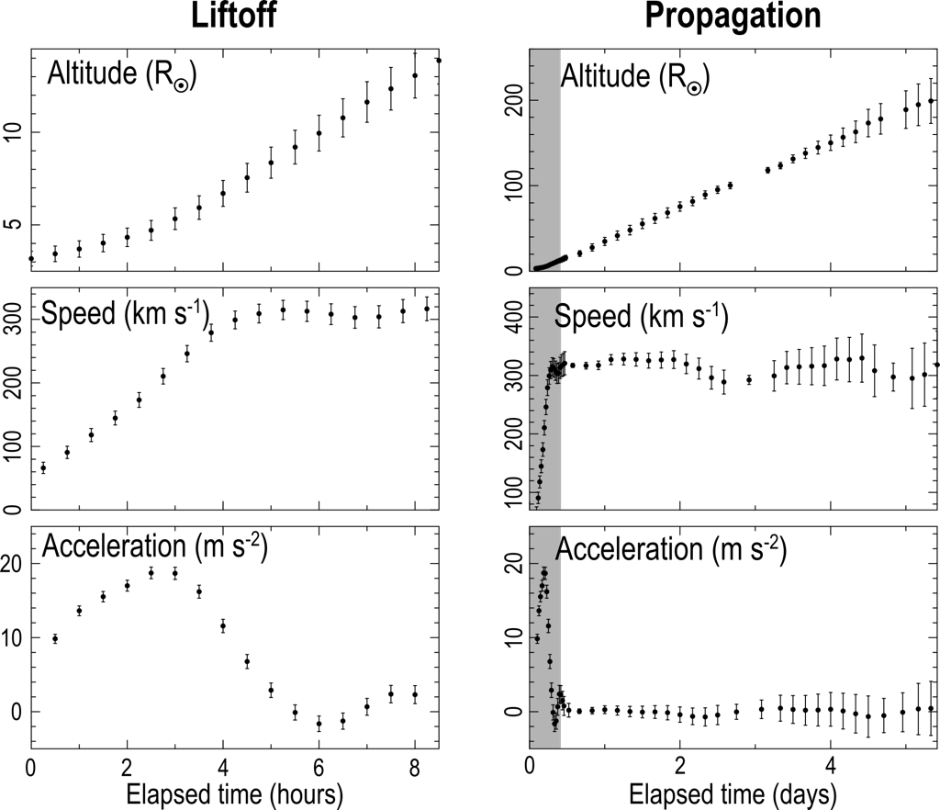
Analysis of DE in Solar Wind
14

Slide 15
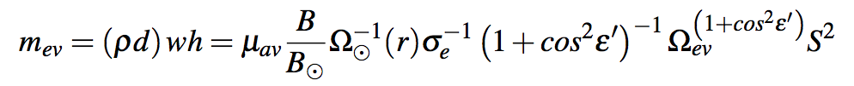
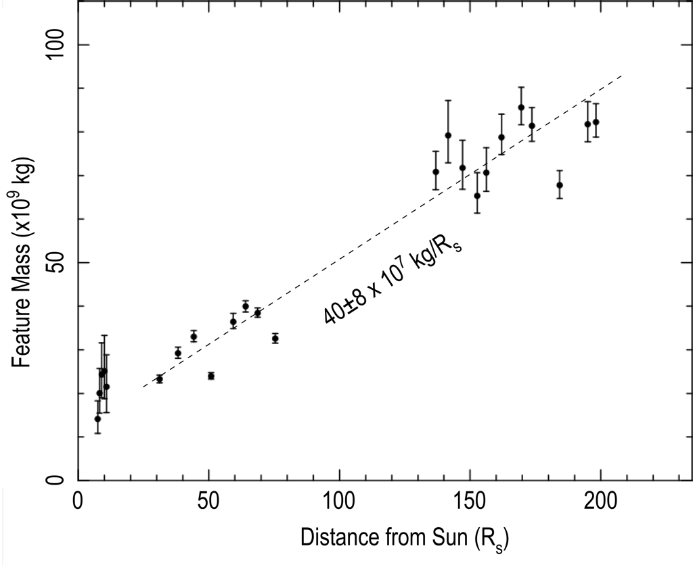
Analysis of DE in Solar Wind
S²
Distance to feature
Apparent size of feature
Thomson geometric factor
Thomson cross section
Accretion in 1 AU:
from 20 Tg to 80 Tg (4X!)
Solar solid angle from feature’s vantage
Feature brightness
Average mass per electron (proton mass * 1.1)
15

Slide 16


CONCLUSIONS
CMEs carry magnetic flux & helicity into heliosphere but flux buildup not observed
Evidence of current sheets and disconnection (C-O struc., rays) observed in lower atmosphere and corona
- Rays/CSs in at least 10% of all WL CMEs
- But are they frequent enough to balance flux?
- Some CS parameters measured but we need a full description
In new STEREO SECCHI data set CME structures and DE features now easily visible and common, even at solar minimum
In one STEREO DE, it accretes 4X its initial mass over 1 AU
- DE has entrained flux = 2 X 10¹⁹ Mx
- Calculations suggest this mechanism important to heliospheric flux balance
SWRI will reprocess all SECCHI-A HI images this year, then SECCHI-A movies, then reprocess SECCHI-B images.
- Catalog DEs and compare with CSs in coronagraph data
- Calculate DEs trajectories and study in-situ characteristics
- Correlate DE rates with CMEs and QS/HCS
- Determine DE/CME role in heliospheric flux balance

Slide 17
Thanks for your attention.
David Webb
617-552-6135
David.Webb@bc.edu

Slide 18
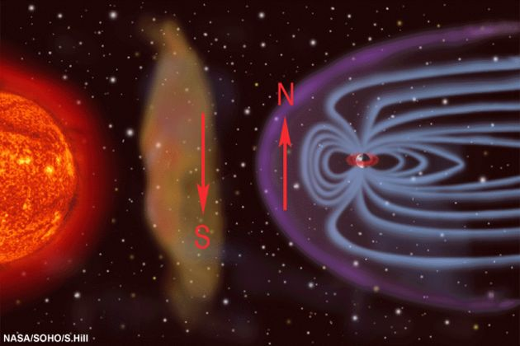
CMEs: What are They and
Why Are They Important?
Large-scale magnetized plasma ejected from the Sun (part of corona is expelled)
CMEs propagate into the heliosphere impacting planets, comets, etc. in the solar system
Driving forces not well understood, but related to solar magnetic fields. The fields, primarily via the Lorentz force (j X B), help push the coronal material out of solar gravitational potential well. Driving can continue well into heliosphere (~0.5 AU).
One of the three ways in which mass is expelled from the Sun:
- CMEs
- Solar energetic particles (SEPs)
- Solar wind
CMEs inject large amounts of mass & mag. fields into Heliosphere – interesting physics
Key link between solar activity & large interplanetary (IP) disturbances
- Most energetic phenomenon in heliospace (10²⁶ J)
- Laboratory for universal physical processes
Most major geostorms driven by CMEs
Long-dur. SEPs originate from CME-driven shocks
Importance of HALO CMEs:
  - Studying Source Regions near Center of Sun
  - Sampling Internal Structure Along Sun-Earth line
  - Forecasting Space Weather at Earth

Slide 19
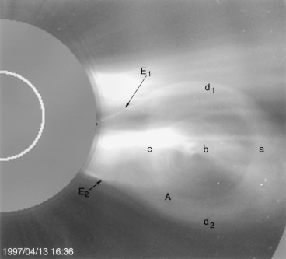
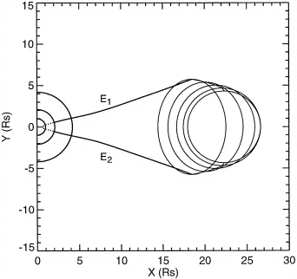
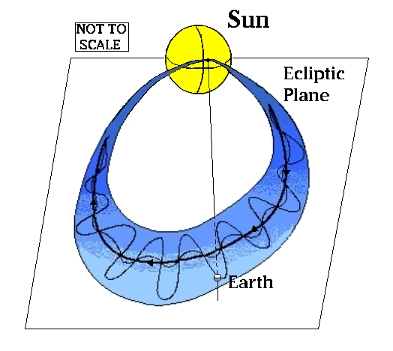
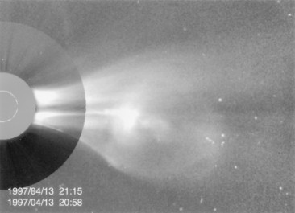
CME → Flux Rope; 13 April 1997
LASCO C2 - 16:36
Chen et al.,
Ap.JL, 1997
LASCO C2 - 21:15 C3 - 20:58

Slide 20
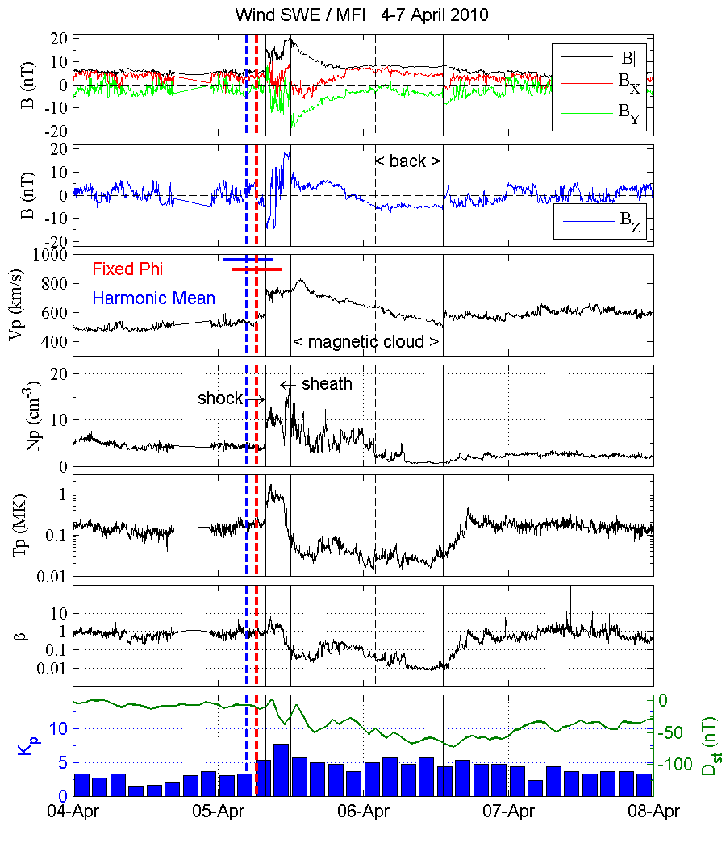
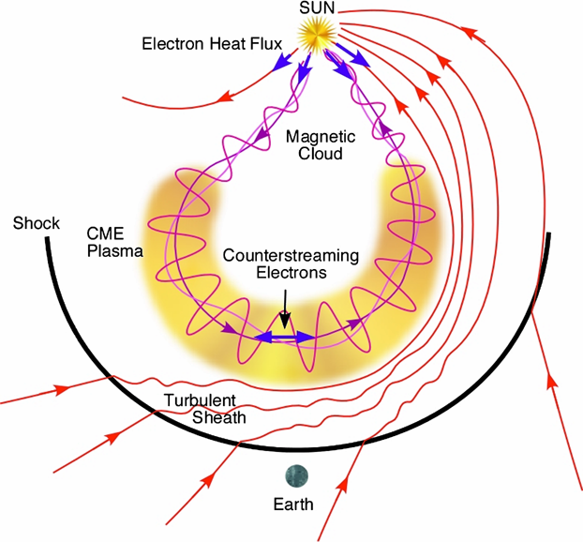
Possible Relation of CMEs to I(nterplanetary) CMEs

Slide 21
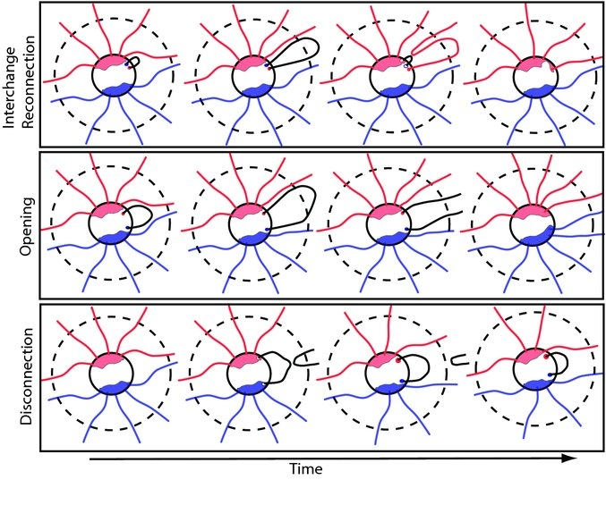
Imaging CMEs & DEs in the Heliosphere
Three processes considered in heliospheric magnetic flux balance :
Interchange reconnection destroys closed magnetic flux, displaces pre-existing field lines open to the heliosphere, and leads to distortions in coronal holes. IR does not change levels of P-E heliospheric flux.
CMEs eject loops which can add to heliospheric flux. Opening process increases area of CHs.
Disconnection removes P-E open flux open and reduces area of CHs. Dashed line shows Alfvén surface (typically 10-15 Rs); reconnection must occur below it to affect the long-term heliospheric flux.
Schwadron et al., ApJ, 2010

Slide 22
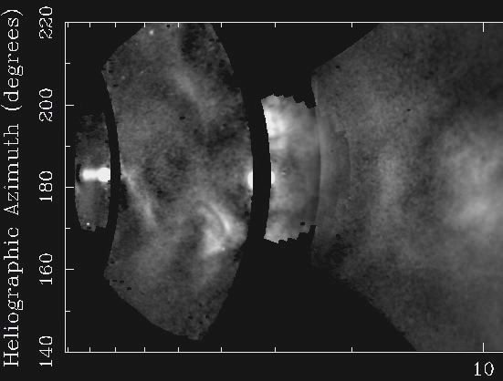
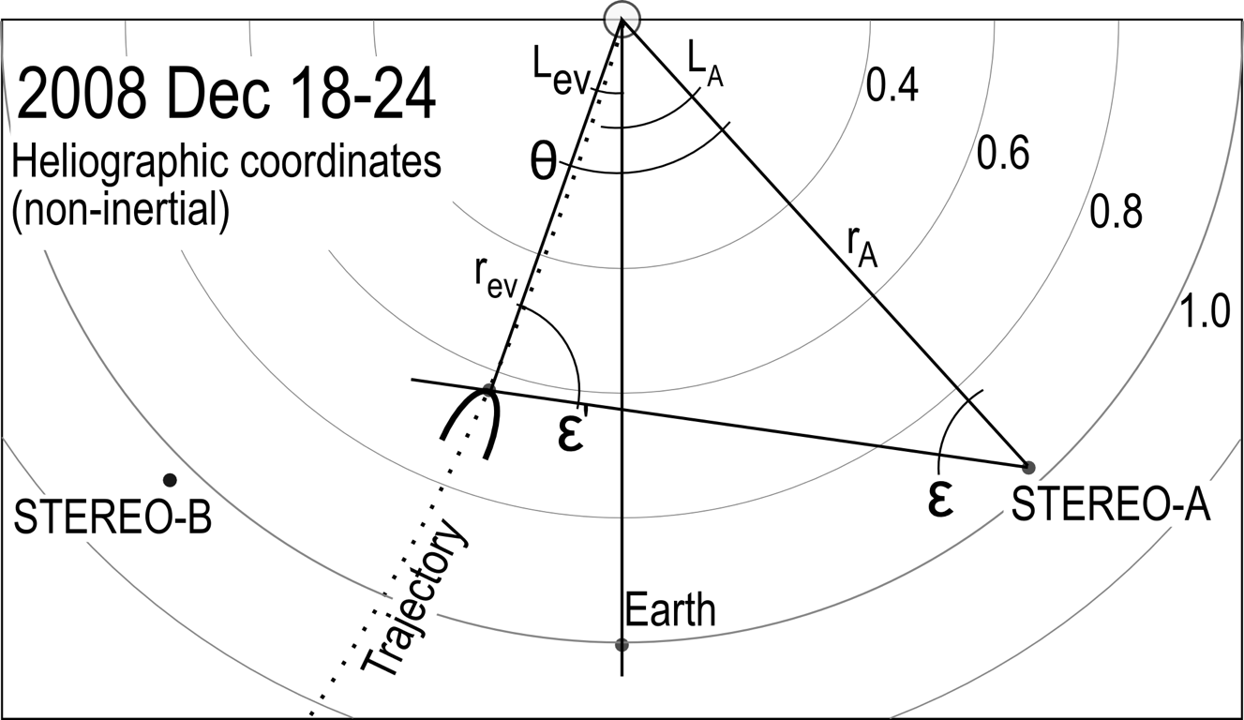
Disconnection Event
13

